Slide 1

Facilitating User Interaction With Data
Zeinab Zolaktaf Zadeh
PhD Defense Exam
Supervisor: Rachel Pottinger
Supervisory Committee: Laks Lakshmanan, Raymond Ng

Slide 2









UberEats
My thesis focuses on facilitating
user interaction with the data
in these types of platforms
Company
End Users

Slide 3
UberEats
Company
Analyze eater ratings on restaurants

Slide 4
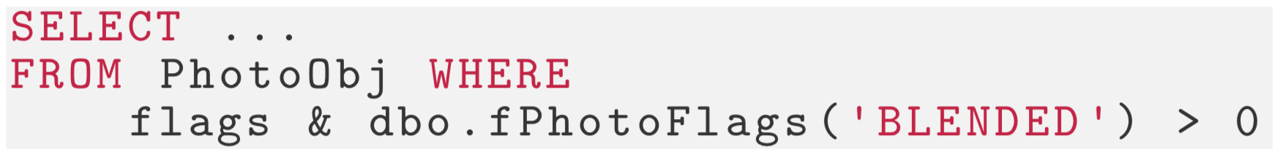

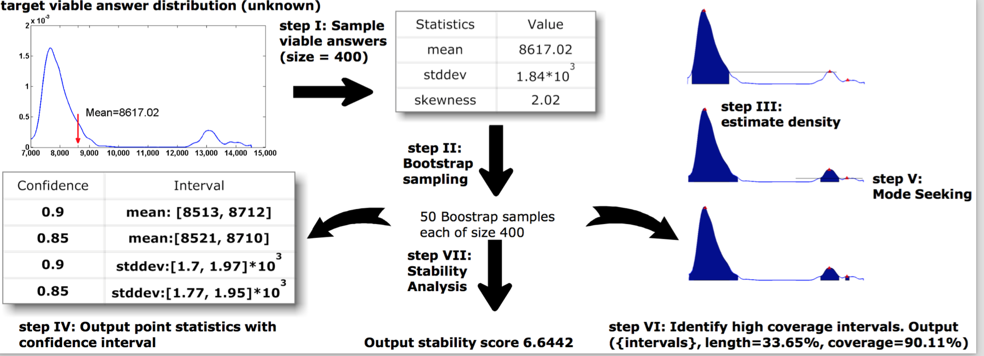
UberEats
Company
End Users
5min
1min
SQL Query Insights
Restaurant Recommendation
Query Result Interpretation
Restaurants located in areas with high traffic in evenings.

Slide 5
Part 1: Facilitating Data Exploration
End Users
Restaurant Recommendation
Zainab Zolaktaf, Reza Babanezhad, and Rachel Pottinger. "A Generic Top-N Recommendation Framework For Trading-off Accuracy, Novelty, and Coverage." 2018 IEEE 34th International Conference on Data Engineering (ICDE). IEEE, 2018.
Zainab Zolaktaf, Omar AlOmeir, and Rachel Pottinger. "Bridging the Gap Between User-centric and Offline Evaluation of Personalized Recommendation Systems." Adjunct Publication of the 26th Conference on User Modeling, Adaptation and Personalization. ACM, 2018

Slide 6


Motivation: Facilitating Data Exploration
Top-N recommendation
Recommend to each user a set of N items from a large collection of items
Restaurants to eaters on UberEats
Problem
Tend to recommend things users are already aware of
E.g., Suggests “Pizza Hut” to users who have rated “Dominos”
Notes:
Tend to recommend things users are already aware of
Suggests “Star Wars: The Force Awakens” to users who have seen “Star Wars: Rogue One”
But those users are probably already aware of “The Force Awakens”

Slide 7
Motivation: Facilitating Data Exploration
Many recommendation systems
Analyze interaction data (e.g., ratings)
Optimize for accuracy
Data suffers from popularity bias and sparsity
Focus on popular items to maintain accuracy [CKT10, Ste11, Ste13]
Effective recommendations?
Novelty
Good for eaters
Coverage
Good for restaurants
Less focus on popular items?
Long-tail items
Generate the lower 20% of the observations
Empirically validated: Correspond to almost 85% of the items in several datasets
Notes:
About elly : less known Iranian movie by Asghar Farhadi
Wonder Wheel: new movie by woody allen
Accuracy alone is not leading to effective suggestions?

Slide 8
Challenges: Accuracy, Novelty, and Coverage Trade-offs
Promoting long-tail items can increase novelty [Ste11]
Long-tail items are more likely to be unseen
Promoting long-tail items increases coverage [Ste11]
Generates revenue for providers of items
Long-tail promotion can reduce accuracy [Ste11]
Not all users receptive of long-tail items

Slide 9
Related Work: Re-ranking Frameworks
Re-rank predictions of a base recommender to optimize for additional objectives [AK12, HCH14]
Advantage
Computationally efficient
Limitations
Trade-off parameters are not personalized per user
But users have varying levels of preference for different objectives
Often limited to a specific base recommender that may be sensitive to dataset density
Datasets are pruned and problem is examined in dense settings.

Slide 10
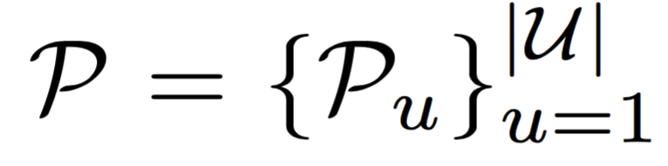
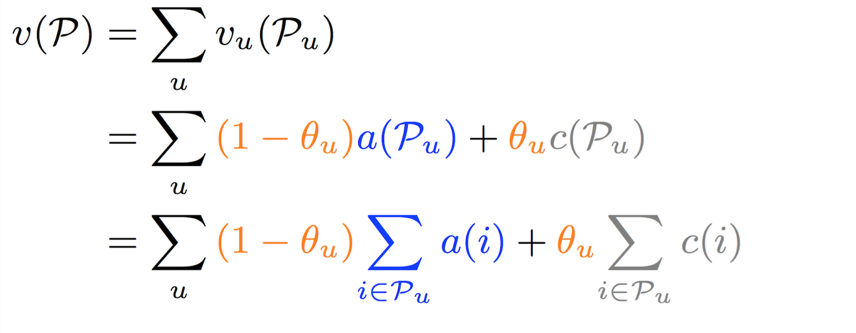
Approach Overview: GANC
A Generic top-N recommendation framework that provides customized balanced between Accuracy, Novelty, and Coverage
Objective: Assign top-N sets to all users
Find , the collection of top-N sets to maximize

Slide 11
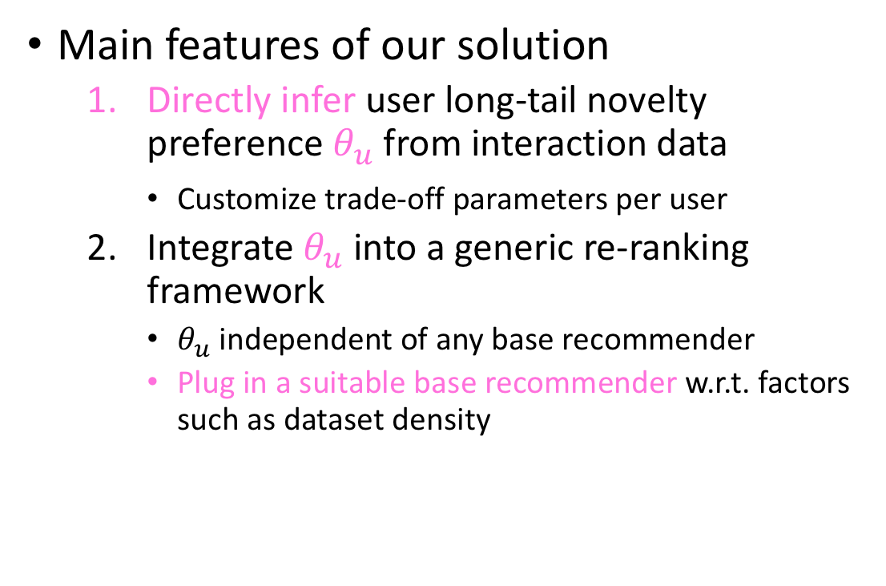
Approach Overview: GANC
Main features of our solution
Directly infer user long-tail novelty preference $θ_{u}$ from interaction data
Customize trade-off parameters per user
Integrate$θ_{u}$ into a generic re-ranking framework
$θ_{u}$ independent of any base recommender
Plug in a suitable base recommender w.r.t. factors such as dataset density

Slide 12
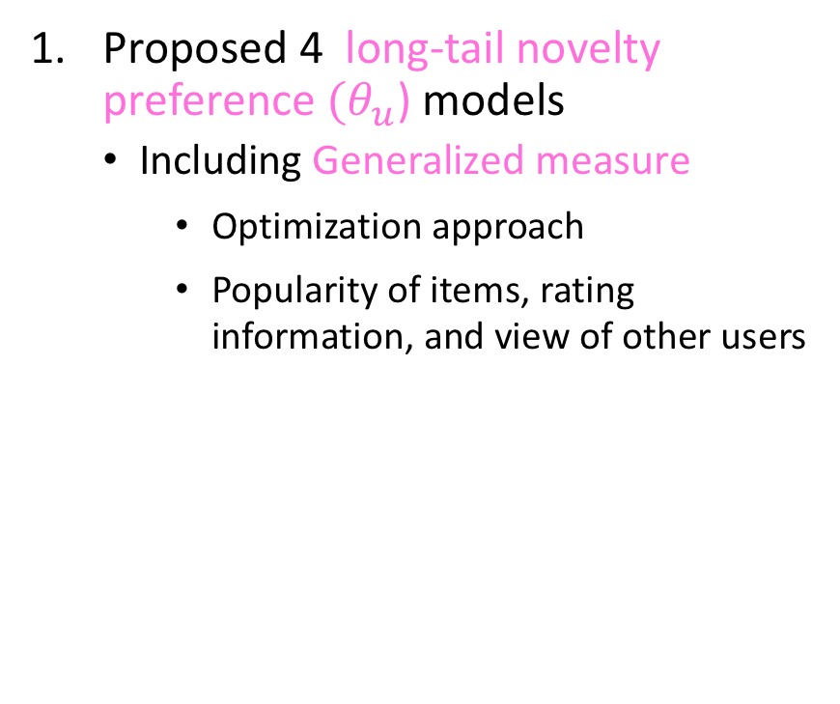
Approach Overview: GANC Features
Proposed 4 long-tail novelty preference ${(θ}_{u}$) models
Including Generalized measure
Optimization approach
Popularity of items, rating information, and view of other users
Notes:
Activity measure
Number observations in train set
Normalized long-tail measure
Incorporates popularity of items
TFIDF-Measure
Incorporates rating and popularity of items
Generalized measure
Optimization approach
Incorporates rating information, popularity of items, and view of other users

Slide 13
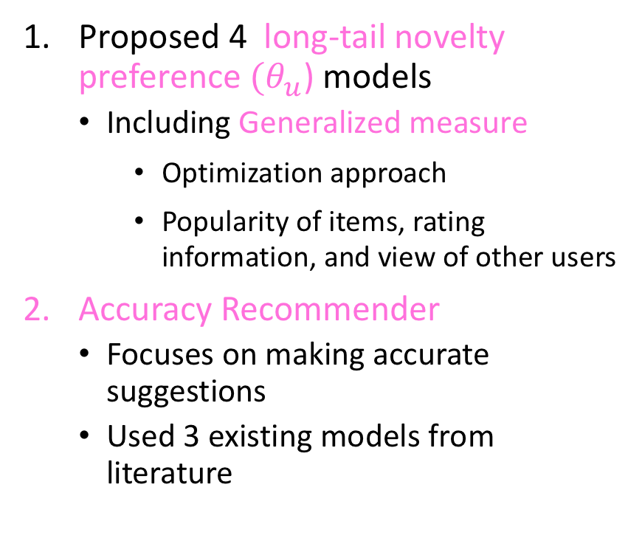
Approach Overview: GANC Features
Proposed 4 long-tail novelty preference ${(θ}_{u}$) models
Including Generalized measure
Optimization approach
Popularity of items, rating information, and view of other users
Accuracy Recommender
Focuses on making accurate suggestions
Used 3 existing models from literature

Slide 14
Approach Overview: GANC Features
Proposed 4 long-tail novelty preference ${(θ}_{u}$) models
Including Generalized measure
Optimization approach
Popularity of items, rating information, and view of other users
Accuracy Recommender
Focuses on making accurate suggestions
Used 3 existing models from literature
Coverage Recommender
Focuses on increasing coverage of item space in suggestions
GANC with Dynamic coverage
Submodular function maximization s.t. a partition matroid constraint
Locally greedy is not scalable!
Designed a scalable sampling-based locally greedy algorithm using the long-tail novelty preference.

Slide 15
Results: Re-rankings for Rating-prediction
Dense dataset (ML-1M)
Evaluated 3 aspects
Measured by different metrics
Lower height is better
Corresponds to better rank
RSVD is base accuracy recommender
GANC
Outperforms RSVD in 4 metrics, including accuracy
Obtains best average performance

Slide 16
Contributions: Facilitating Data Exploration
Developed 4 long-tail novelty preference measures
Including generalized measure
Developed GANC, a generic re-ranking framework
Introduce a scalable algorithm that relies on user novelty preferences
Extensive empirical study considers
Accuracy, coverage, and novelty aspects
Impact of dataset density
Results confirm performance of re-ranking models is impacted by base recommender algorithm
In dense settings, using the same base recommender as existing models, we improve upon all metrics
In sparse settings, we plugin a more suitable base recommender
GANC is competitive with existing top-N recommendation models
Notes:
integrate the preferences into
we are the first to do this kind of evaluation

Slide 17
Part 1: Facilitating Data Exploration
Company
End Users
Restaurant Recommendation

Slide 18
Part 2: Facilitating SQL Query Composition and Analysis
Company
End Users
1min
SQL Query Insights
Restaurant Recommendation
Zainab Zolaktaf, Mostafa Milani, and Rachel Pottinger. ”Facilitating SQL query composition and analysis.” Under revision, 2019.

Slide 19
Motivation: Facilitating SQL Query Composition and Analysis
Inefficient SQL queries pose a burden
On system and programmer
To write efficient SQL queries
Gain knowledge of database schema, tuples
Use hints or tutorials from system
Write ``Count’’ query first!
Provide SQL query performance insights - prior to execution
Company
SQL Query Insights
Notes:
Inefficient SQL queries
Detrimental for both system resources and user time and effort
Expensive, e.g. ,Google BigQuery
Look at queries of other users

Slide 20
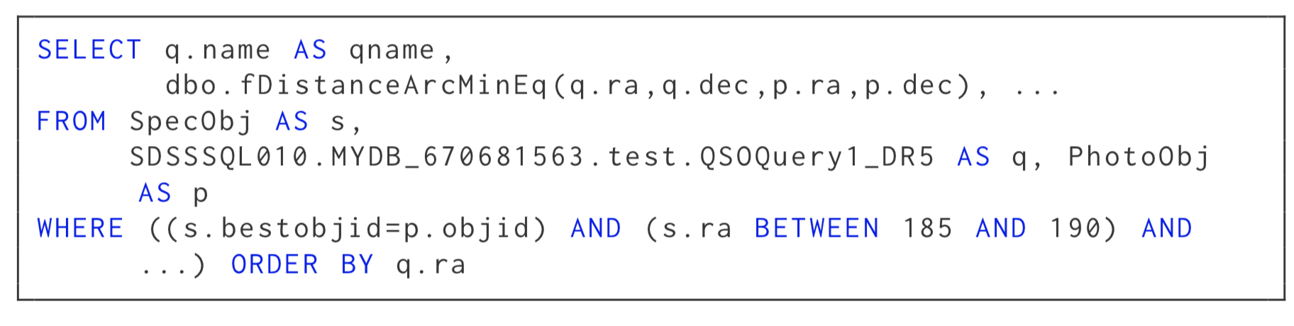
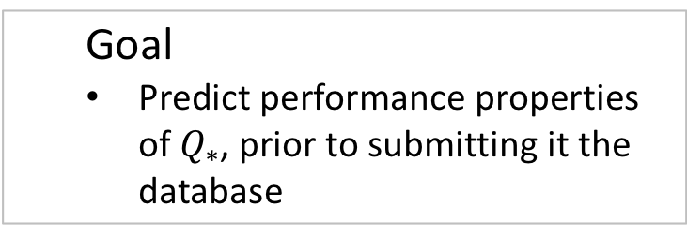
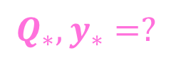
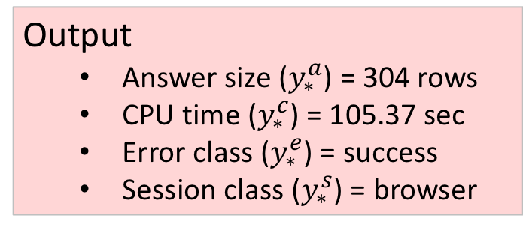
Motivation: Facilitating SQL Query Composition and Analysis
A new SQL query
$Q_{∗},y_{∗}=?$
Goal
Predict performance properties of $Q_{∗}$, prior to submitting it the database
Output
Answer size ($y_{∗}^{a}$) = 304 rows
CPU time ($y_{∗}^{c}$) = 105.37 sec
Error class ($y_{∗}^{e}$) = success
Session class ($y_{∗}^{s}$) = browser
Notes:
Humans, BOTs, PROGRAMS, System Administrators
Helps system administrators improve services
Answer size prediction
CPU time prediction
Error classification
Session classification
Identify who wrote the query
E.g. bot, browser, program, …

Slide 21
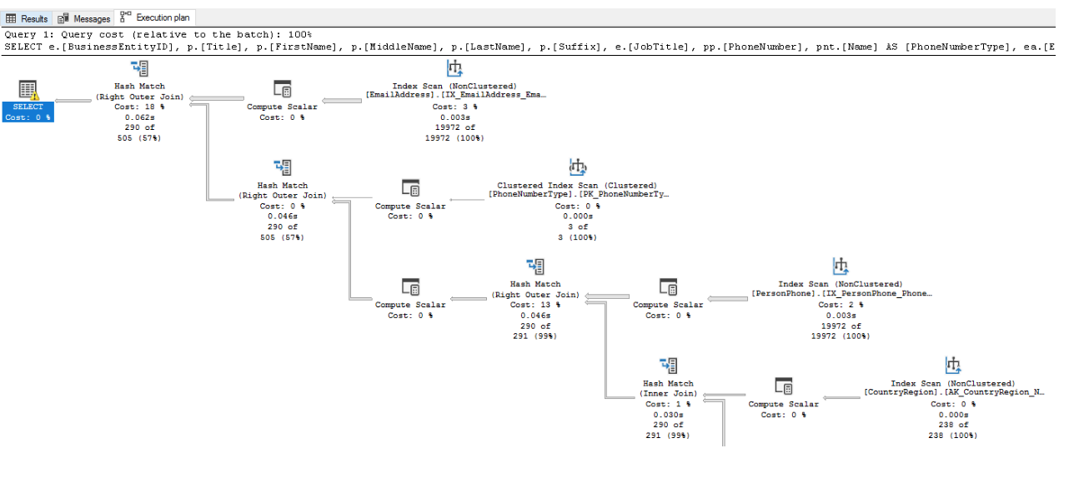
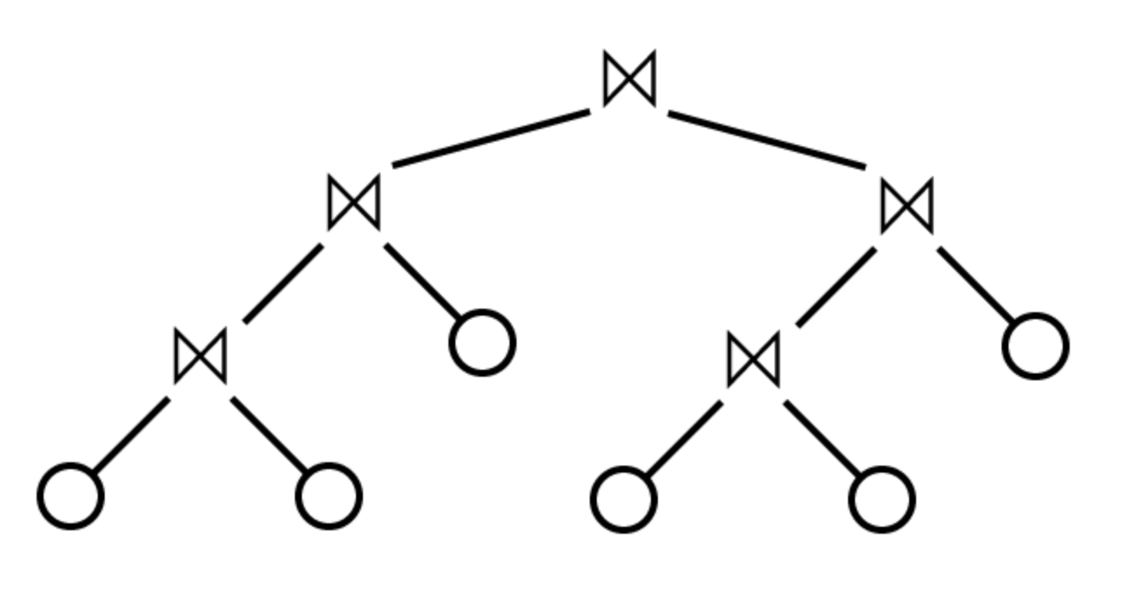
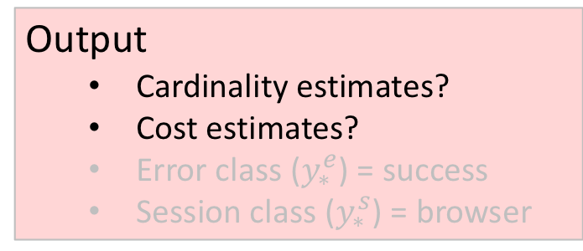
Challenges: Database Instance
Existing models for query performance prediction
System side applications (e.g., admission control, query optimization [LKNC12])
Use query execution plan
Need database instance and statistics
Problems
Query execution plan can be imprecise [LGMB15]
Limited access to database instance?
Sources on the hidden web
Customers of cloud data warehouses
Spotify, HSBC use Google BigQuery
Output
Cardinality estimates?
Cost estimates?
Error class ($y_{∗}^{e}$) = success
Session class ($y_{∗}^{s}$) = browser
Notes:
Private databases with sensitive information
Sources on the hidden web
Admission control: when a query is submitted to a dbms, the system has to consider resource requirements of the query and compare with available resouces, to determine if to execute the query or to delay it.
Query optimization,
QEP:
+ Has to work for any configuration
Real-time predictions
Needs access to database instance and might expose some information in the database
statistical model
Works for specific configurations of hardware
+offline training where you can optimize it’s performance

Slide 22
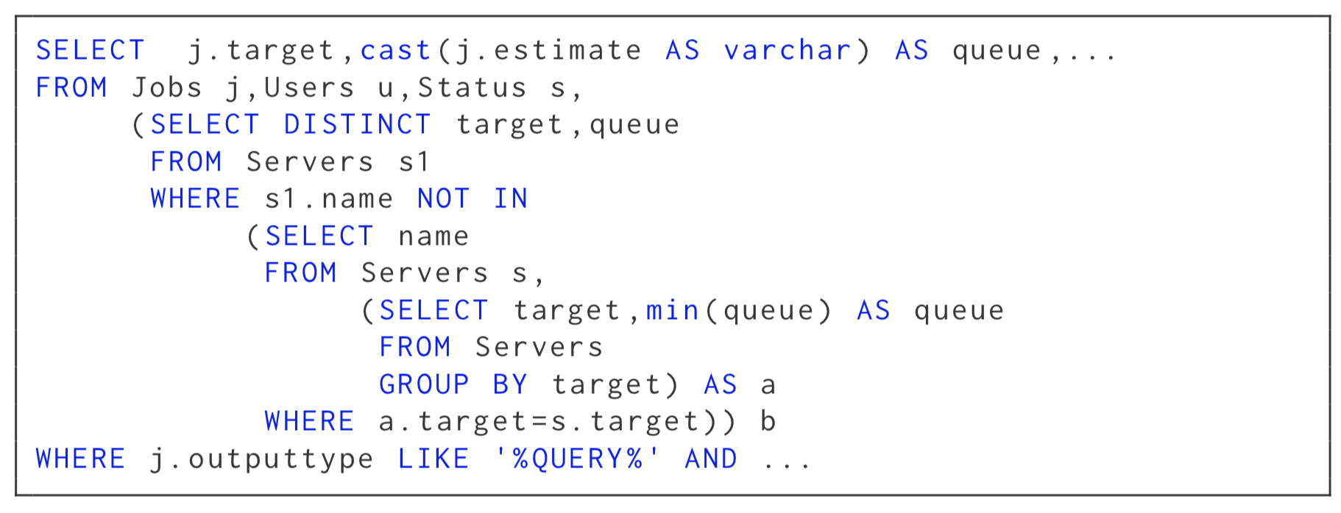
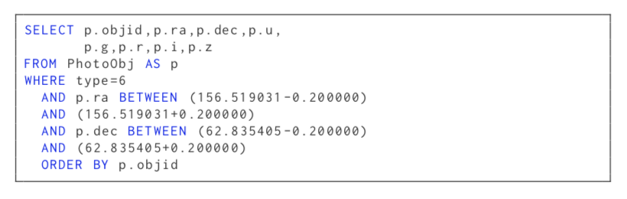
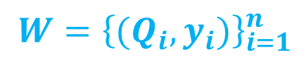
Challenges: Large-scale Query Workloads
$$W={\left\{{(Q}_{i},y_{i})\right\}}_{i=1}^{n}$$
SQL Query workload (W)
Collection of labeled SQL queries submitted in the past
Labels are actual observations
Eliminate biases e.g., cardinality misestimates
Easily logged by DBMS
Need large-scale and real-world query workloads
Usage patterns from a variety of users
Sloan Digital Sky Server (SDSS) [RTS14]
Scientific computing domain
Extracted ~600K SQL queries
SQLShare [JMH16]
SQL-as-a-Service
Users upload data, write queries
Contains ~27K SQL queries

Slide 23
Problem Formulation: Facilitating SQL Query Composition and Analysis
Collection of labeled SQL queries
A new SQL query
$$W={\left\{{(Q}_{i},y_{i})\right\}}_{i=1}^{n}$$
$Q_{∗},y_{∗}=?$
Goal
Predict performance properties of $Q_{∗}$, prior to submitting it the database
Output
Answer size ($y_{∗}^{a}$) = 304 rows
CPU time ($y_{∗}^{c}$) = 105.37 sec
Error class ($y_{∗}^{e}$) = success
Session class ($y_{∗}^{s}$) = browser
Notes:
Humans, BOTs, PROGRAMS, System Administrators
Helps system administrators improve services
Answer size prediction
CPU time prediction
Error classification
Session classification
Identify who wrote the query
E.g. bot, browser, program, …

Slide 24



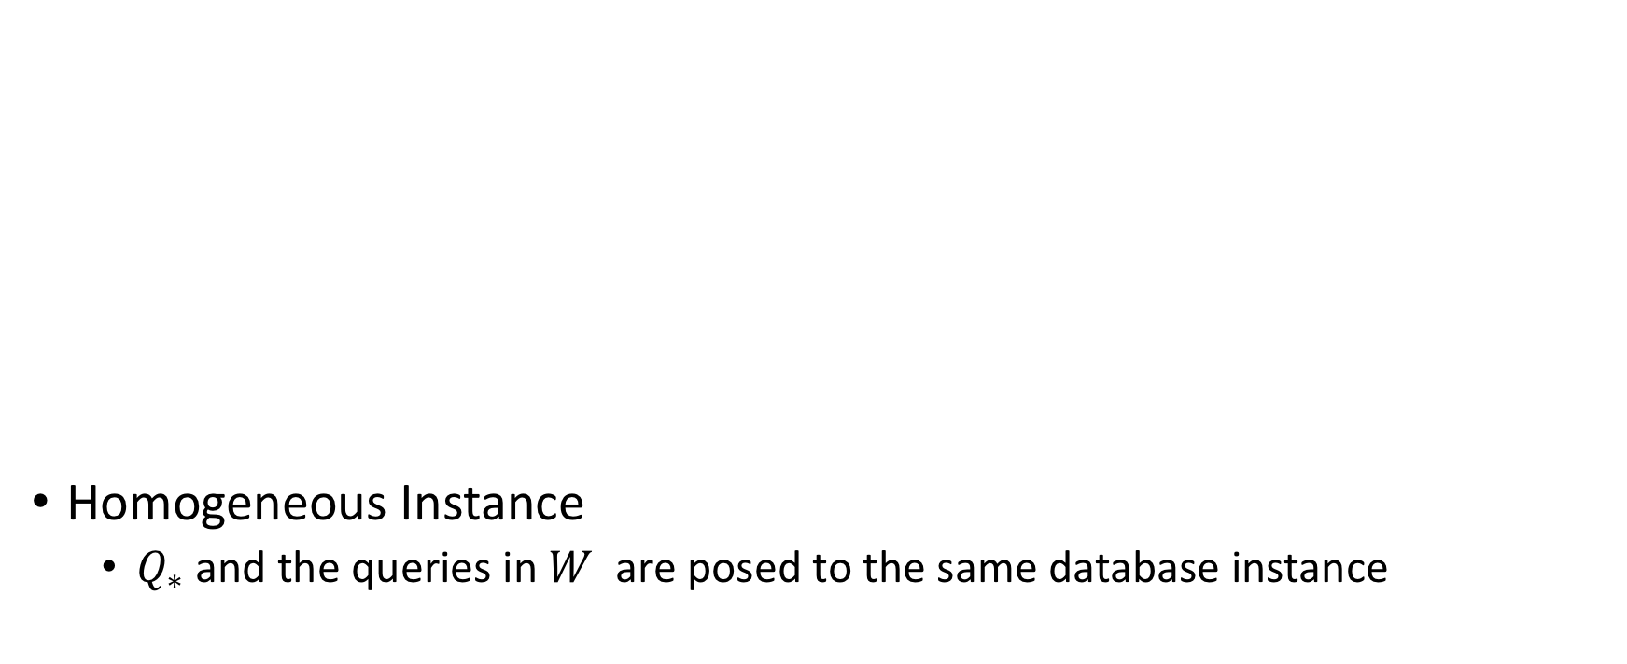
Approach Overview: Different Settings
Homogeneous Instance
$Q_{∗}$ and the queries in $W$ are posed to the same database instance
$$W={\left\{{(Q}_{i},y_{i})\right\}}_{i=1}^{n}$$
$Q_{∗},y_{∗}=?$
SDSS

Slide 25
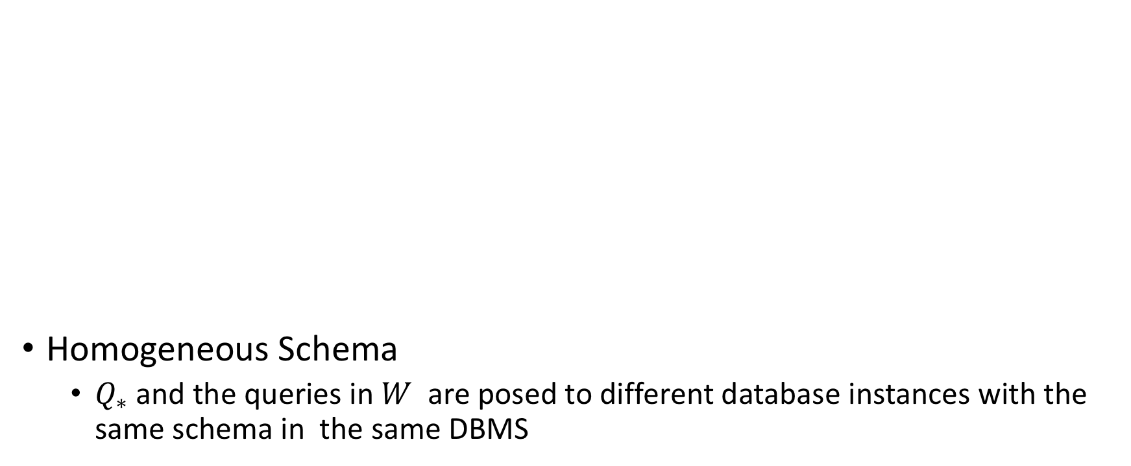
Approach Overview: Different Settings
Homogeneous Schema
$Q_{∗}$ and the queries in $W$ are posed to different database instances with the same schema in the same DBMS
$$W={\left\{{(Q}_{i},y_{i})\right\}}_{i=1}^{n}$$
$Q_{∗},y_{∗}=?$
SQLShare

Slide 26
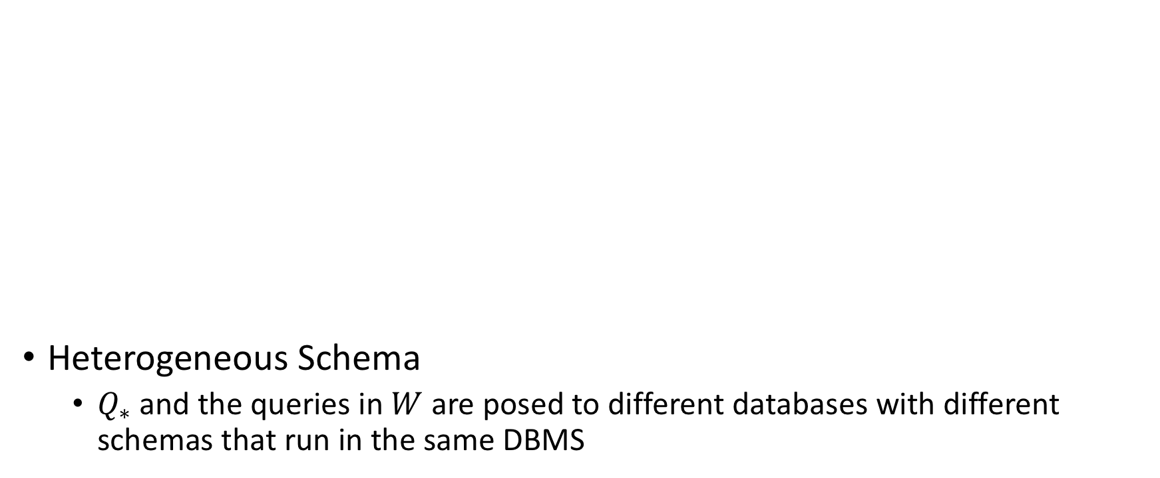
Approach Overview: Different Settings
Heterogeneous Schema
$Q_{∗}$ and the queries in $W$ are posed to different databases with different schemas that run in the same DBMS
$$W={\left\{{(Q}_{i},y_{i})\right\}}_{i=1}^{n}$$
$Q_{∗},y_{∗}=?$
SQLShare

Slide 27
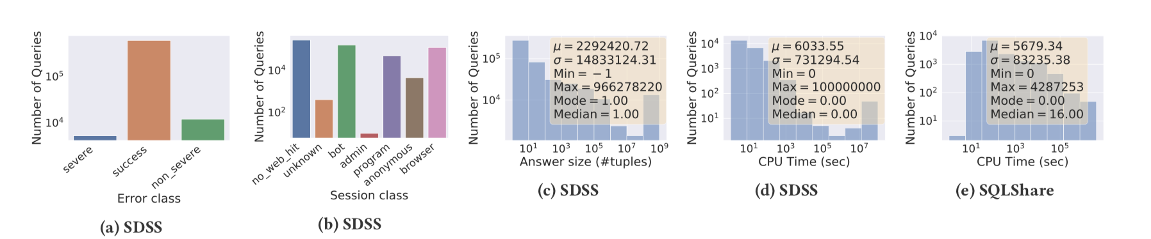
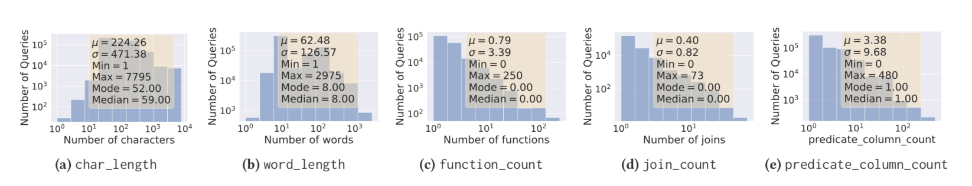
Approach Overview: Workload Analysis
Perform workload analysis for
Better model selection
Better model evaluation
SQL query statements
Digits and mathematical equations in statements
Affect query performance, e.g., answer size
Range in complexity w.r.t. length, #joins
SQL query labels
Classification labels are imbalanced
Regression labels had a wide range
Notes:
SDSS 30% have char length and word length larger than mean of distribution
Predict SQL query performance properties
Understand data properties
Better evaluation Establish appropriate baselines
Assess feasibility of complex queries
Better evaluation
We want to help users write complex queries
Query statement complexity
Notion should reflect the cognitive effort required to write the query [JMH16]
Number of characters
Some properties are linearly correlated with, and therefore, indicative of other properties
Use subset of structural properties

Slide 28
Approach Overview: Models Evaluated
Broad set of models
Do not consider SQL query statement
Consider SQL query statement
Query statement representation?
Bag-of-n-grams + TFIDF
Shallow Convolutional Neural Network (CNN)
3-Layer Long Short-Term Memory (LSTM)
Applied at character and word level
Most frequent class (mfreq) classifier
Median of distribution for regression

Slide 29
Results: CPU Time Prediction
Goal: Predict logarithm of CPU time
Measure mean squared error (MSE)
Lowest MSE obtained by character-level models
MSE of these models increases as statement complexity (Number of Characters) increases
MSE increases as problem setting complexity increases
Notes:
CPU Time Prediction by Query Character Length Under Various Settings
Traditional models obtain similar performance as Median
Considering session class information
noWebhit, PROGRAM, and BROWSER classes are difficult to predict
they may have more diverse queries.

Slide 30
Contributions: Facilitating SQL Query Composition and Analysis
Introduced and addressed 4 problems for query performance insights - prior to execution
Approach is based on large-scale real-world query workloads
Conduct extensive workload analysis
Adapt data-driven machine learning models
Establish baselines and assess feasibility
Results show character level models (e.g., ccnn) generalize better under different problem settings
Notes:
Character-level models performed better
Neural networks
performing better on other problems such as run-time and answer size prediction
are more accurate in predicting the error class, achieving a higher F-measure on classes with fewer samples
Character-level models perform better
neural networks are more accurate in predicting several of the problems, including a higher f-measure on classes with fewer samples

Slide 31
Part 2: Facilitating SQL Query Composition and Analysis
Company
End Users
1min
SQL Query Insights
Restaurant Recommendation

Slide 32
Part 3: Facilitating SQL Query Answer Analysis
Company
Company
End Users
1min
SQL Query Insights
Restaurant Recommendation
Query Result Interpretation
Zainab Zolaktaf, Jian Xu, and Rachel Pottinger. " Extracting aggregate answer statistics for integration." 18th International Conference on Extending Database Technology (EDBT), 2015.

Slide 33
Motivation: Value-level Heterogeneity
Traffic:
What is the average time from location C to location D?
Source | Destination | Duration | Date
A | K | 40min | 2-Jan-2019
A | C | 5min | 2-Jan-2019
C | D | 21min | 5-Jan-2019
… | … | … | …
Source | Destination | Duration | Date
A | B | 5min | 1-Jan-2019
C | D | 11min | 5-Jan-2019
… | … | … | …
Standard aggregation requires averaging over all data points
Can lead to information loss
Correct aggregation requires one value per data point
Define a viable answer as a possible answer
Aggregate query
In integration contexts
Requires combining sets of data values that come from multiple sources
Notes:
Aggregate queries Group sets of data values, calculate informative statistics (e.g., sum)
Sources have inconsistent or conflicting values for the same data points
Answering aggregate queries in integration contexts
Requires combining sets of data that are segmented across multiple sources
Some points have duplicates across sources
They may have conflicting values
Which set of sources and values to use?

Slide 34
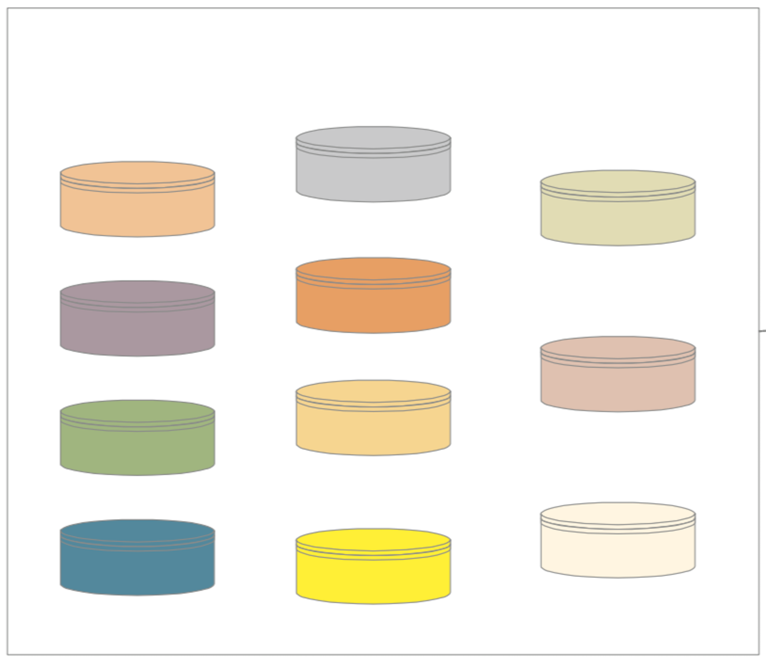
Challenges: Different combination of sources and values are possible
Which set of sources and values to use?
Viable answer 1
Compute
Avg (Time) from A to B

Slide 35
Challenges: Different combination of sources and values are possible
Which set of sources and values to use?
Viable answer 1
Viable answer 2
Compute
Avg (Time) from A to B

Slide 36
Challenges: Different combination of sources and values are possible
Which set of sources and values to use?
Viable answer 1
Viable answer 2
…
…
Viable answer n
Compute
Avg (Time) from A to B

Slide 37
Challenges: Different combination of sources and values are possible
Which set of sources and values to use?
Depending on the choice of sources and value combinations, there can be a whole range of viable answers
Viable answer 1
Viable answer 2
…
…
Viable answer n
Compute
Avg (Time) from A to B

Slide 38
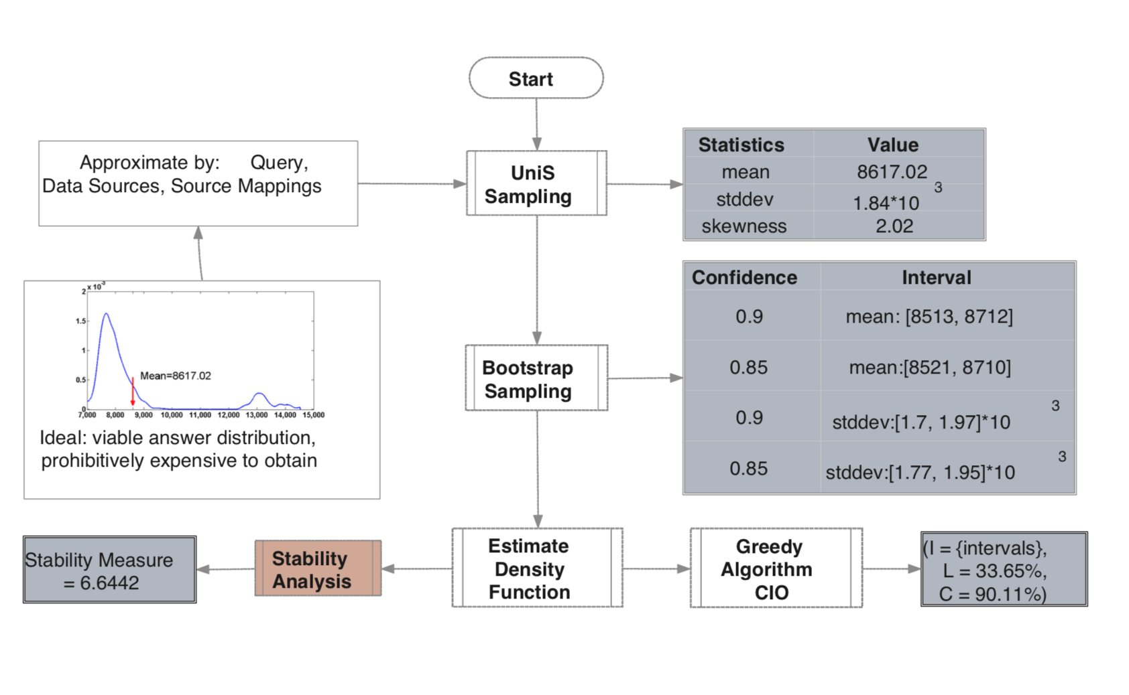
Approach Overview: Framework
Define aggregate answers as a distribution of viable answers instead of single scalar value
Efficiently estimate viable answer distribution and summary statistics
Key point statistics
High coverage intervals

Slide 39
Approach Overview: Sampling and Point Statistics
Goal
Efficiently approximate viable answer distribution
Sample a set of viable answers
No prior knowledge regarding coverage, accuracy and quality
Uniform sampling
Choose sources uniformly at random
Stay at source until source is exhausted (all relevant components used)
Apply bootstrap sampling and bagging
Apply kernel density estimation

Slide 40
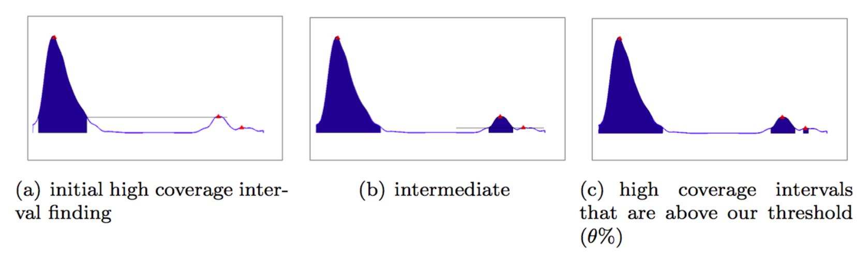
Approach Overview: High Coverage Intervals
Goal
Communicate shape information about viable answer distribution
Greedy algorithm CIO
Minimize interval length so that coverage of viable answers is above a certain threshold
High coverage intervals shaded in dark blue

Slide 41
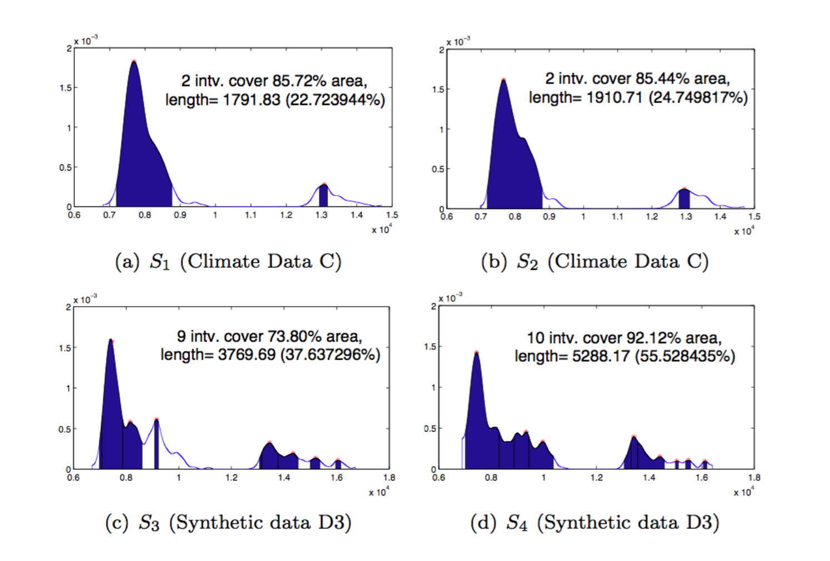
Results: Greedy Algorithm Output
Weather dataset
Real-life and synthetic data
Aggregate query
Sum temperature data over 500 components from datasets
Greedy algorithm output
Cover a small percentage of the range data and a majority of the distribution
Help identify erroneous data
Second high coverage interval due to combining supposedly clean data with values in both Fahrenheit and Celsius
Notes:
Dataset Synthetic data
D2 - Mixtures of four Gaussians
D3 - Mixture of Gaussians, Cauchy and Gamma
Real-life data
C - Monthly Canadian climate data for the year 2006, from 1672 stations for 104 districts
Aggregate query: Sum temperature data over 500 components from datasets
By returning dense areas, the intervals cover a small percentage of the range of data

Slide 42
Contributions: Facilitating Query Answer Analysis
Define aggregate answers as a distribution of viable answers
Use efficient algorithms to provide summary statistics for the viable answer distribution
Key point statistics
High coverage intervals
Verify the effectiveness of methods using real-life and synthetic data

Slide 43
Thesis Contributions
Facilitating Data Exploration (ICDE’18, UMAP’18)
Address Top-N item recommendation
Learn user preferences for discovering less common items
Design a generic Top-N recommendation framework
Evaluate in both dense and sparse settings
Facilitating SQL Query Composition and Analysis (Submitted to SIGMOD’19)
Predict SQL query performance insights – prior to execution
Approach relies on exploiting large real-world query workloads
Extensive evaluation to establish baselines and assess feasibility w.r.t. data properties
Facilitating Query Answer Analysis (EDBT’15)
Address answering aggregate queries in integration contexts and value-level heterogeneity
Propose efficient methods for extracting statistics that convey meaningful information about query answers
Focus on determining useful statistics and efficient computation

Slide 44
Future work
Facilitating data exploration
Incorporate contextual information
Facilitating SQL query composition
Incorporate contextual information and SQL structure for prediction problems
Facilitating answer analysis
Model source freshness and quality

Slide 45
Selected Related work
Accuracy-focused models
KBV09- Koren, Yehuda, Robert Bell, and Chris Volinsky. "Matrix factorization techniques for recommender systems." Computer42.8 (2009).
Re-ranking frameworks
AK12- Adomavicius, Gediminas, and YoungOk Kwon. "Improving aggregate recommendation diversity using ranking-based techniques." IEEE Transactions on Knowledge and Data Engineering 24.5 (2012): 896-911.
HCH14- Ho, Yu-Chieh, Yi-Ting Chiang, and Jane Yung-Jen Hsu. "Who likes it more?: mining worth-recommending items from long tails by modeling relative preference." Proceedings of the 7th ACM international conference on Web search and data mining. ACM, 2014.
Evaluation of top-N recommendation
CKT10- Cremonesi, Paolo, Yehuda Koren, and Roberto Turrin. "Performance of recommender algorithms on top-n recommendation tasks." Proceedings of the fourth ACM conference on Recommender systems. ACM, 2010.
Ste11- Steck, Harald. "Item popularity and recommendation accuracy." Proceedings of the fifth ACM conference on Recommender systems. ACM, 2011.
Ste13- Steck, Harald. "Evaluation of recommendations: rating-prediction and ranking." Proceedings of the 7th ACM conference on Recommender systems. ACM, 2013.
Notes:
[CKT10, Ste11,Ste13]

Slide 46
Selected Related Work
SQL Query Workloads
[LGMB15] Leis, V., Gubichev, A., Mirchev, A., Boncz, P., Kemper, A., & Neumann, T. (2015). How good are query optimizers, really?. Proceedings of the VLDB Endowment, 9(3), 204-215.
[LKNC12Li, Jiexing, Arnd Christian König, Vivek Narasayya, and Surajit Chaudhuri. "Robust estimation of resource consumption for sql queries using statistical techniques." Proceedings of the VLDB Endowment 5, no. 11 (2012):
[BDM19] Bailu Ding, Sudipto Das, Ryan Marcus,Wentao Wu, Surajit Chaudhuri, and Vivek Narasayya. 2019. AI Meets AI: Leveraging Query Executions to Improve Index Recommendations. In Proceedings of the 2019 ACM SIGMOD International Conference on Management of data. SIGMOD’19.
[RTS14] M Jordan Raddick, Ani R Thakar, Alexander S Szalay, and Rafael DC Santos. 2014. Ten Years of SkyServer I: Tracking Web and SQL e- Science Usage. Computing in Science & Engineering 16, 4 (2014), 22–31.
[JMH16] Shrainik Jain, Dominik Moritz, Daniel Halperin, Bill Howe, and Ed Lazowska. 2016. Sqlshare: Results from a multi-year sql-as-a-service experiment. In Proceedings of the 2016 International Conference on Management of Data. ACM, 281–293.

Slide 47
Other slides
Company
End Users
5min
1min
SQL Query Insights
Restaurant Recommendation
Query Result Interpretation

Slide 48
Part 1

Slide 49
Long-Tail novelty preference model (${\text{Θ}}_{u}$)
Activity measure
Number observations in the train set (e.g., number of rated items)
Does not distinguish between long-tail and popular items
Normalized long-tail measure
Ratio of long-tail items they have rated in train set
Does not consider whether user liked the item
TFIDF-Measure
Incorporates rating and popularity of items
Does not consider view of other users
Generalized measure
Optimization approach
Incorporates rating information, popularity of items, and view of other users

Slide 50
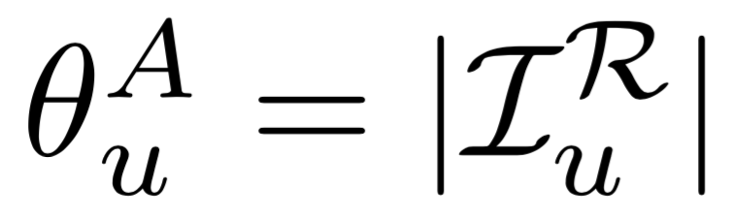
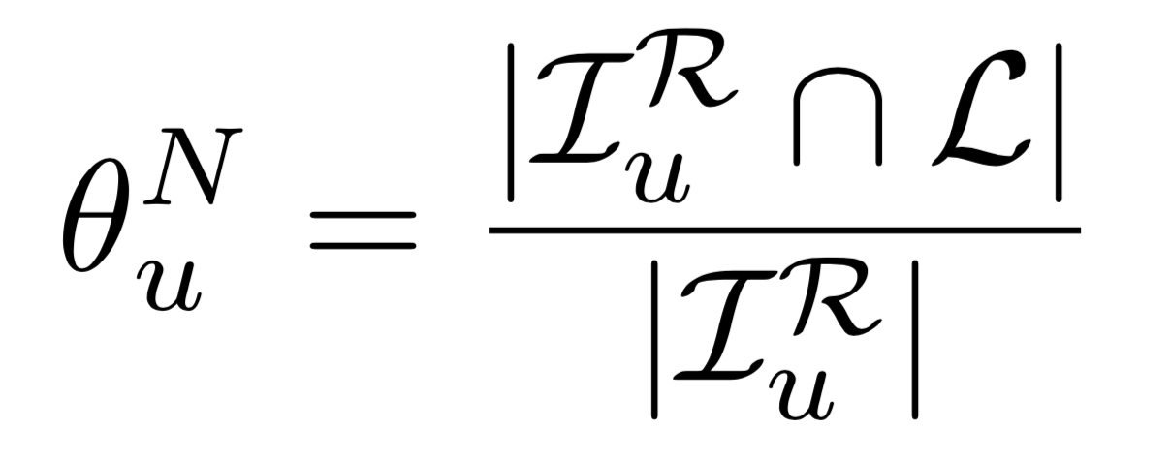
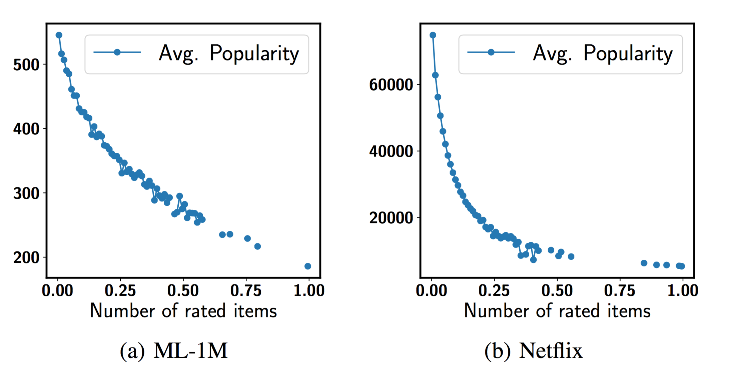
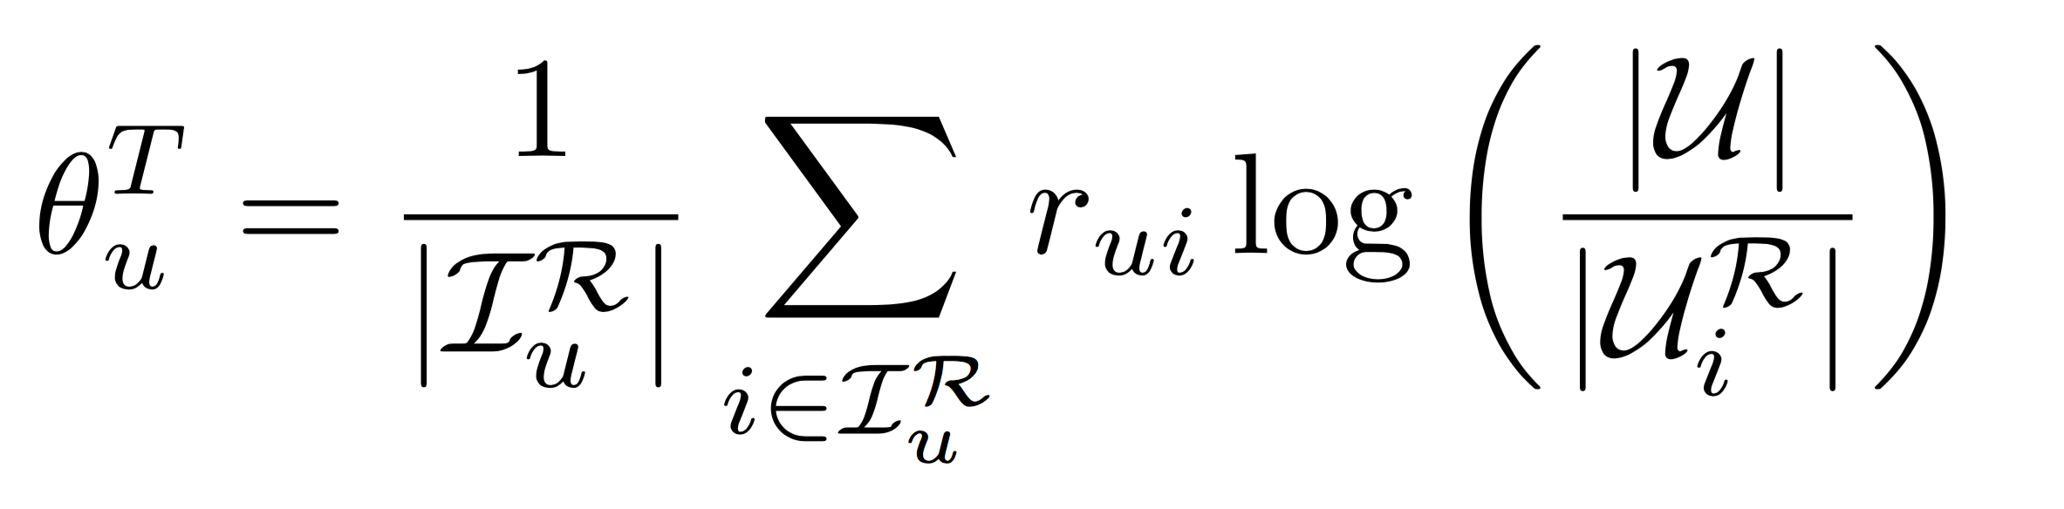
Simple Long-Tail novelty preference models
User Activity
Normalized long-tail measure
TFIDF-Measure

Slide 51
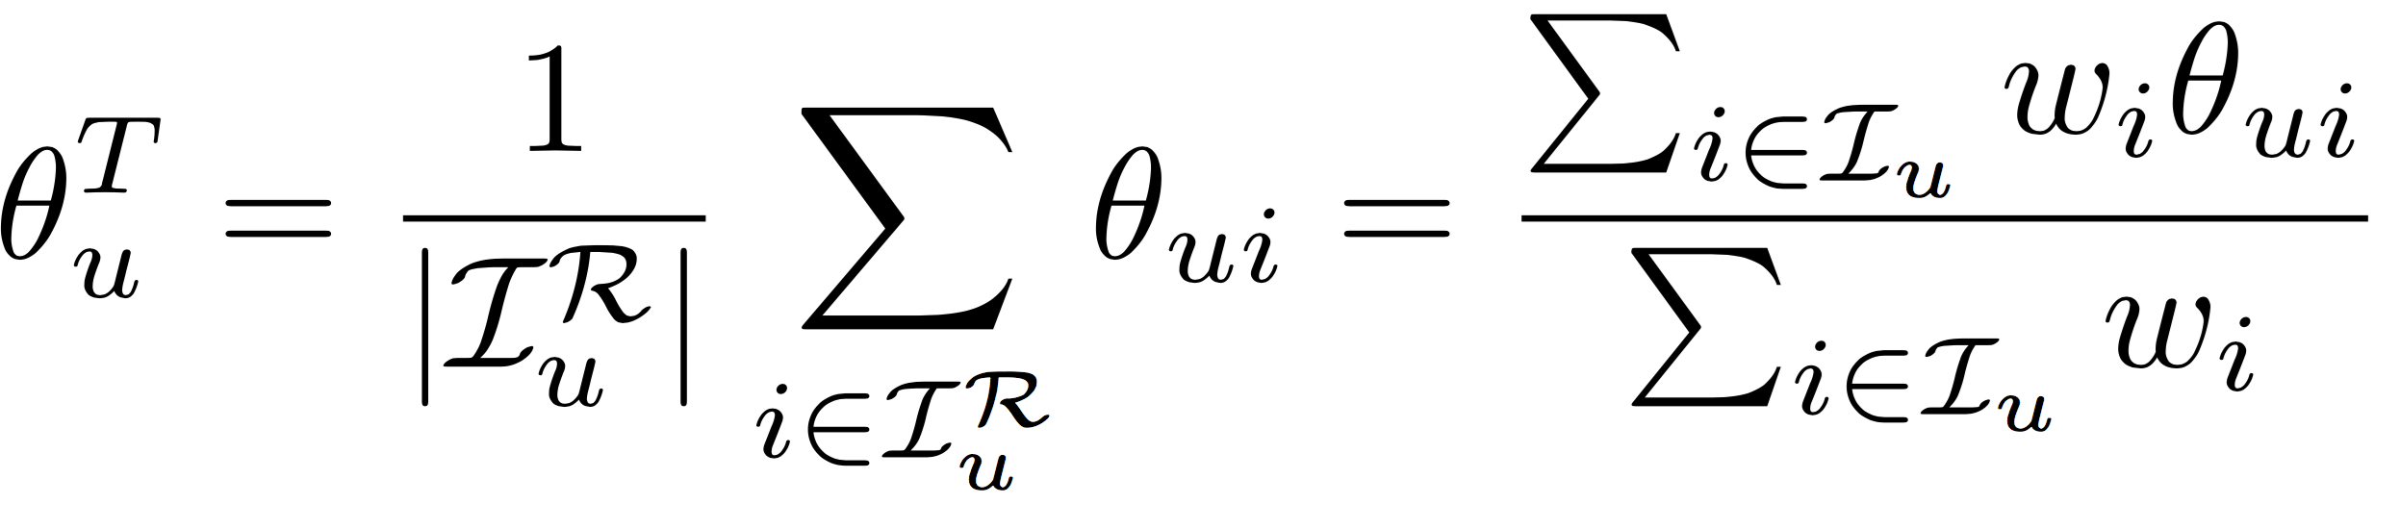
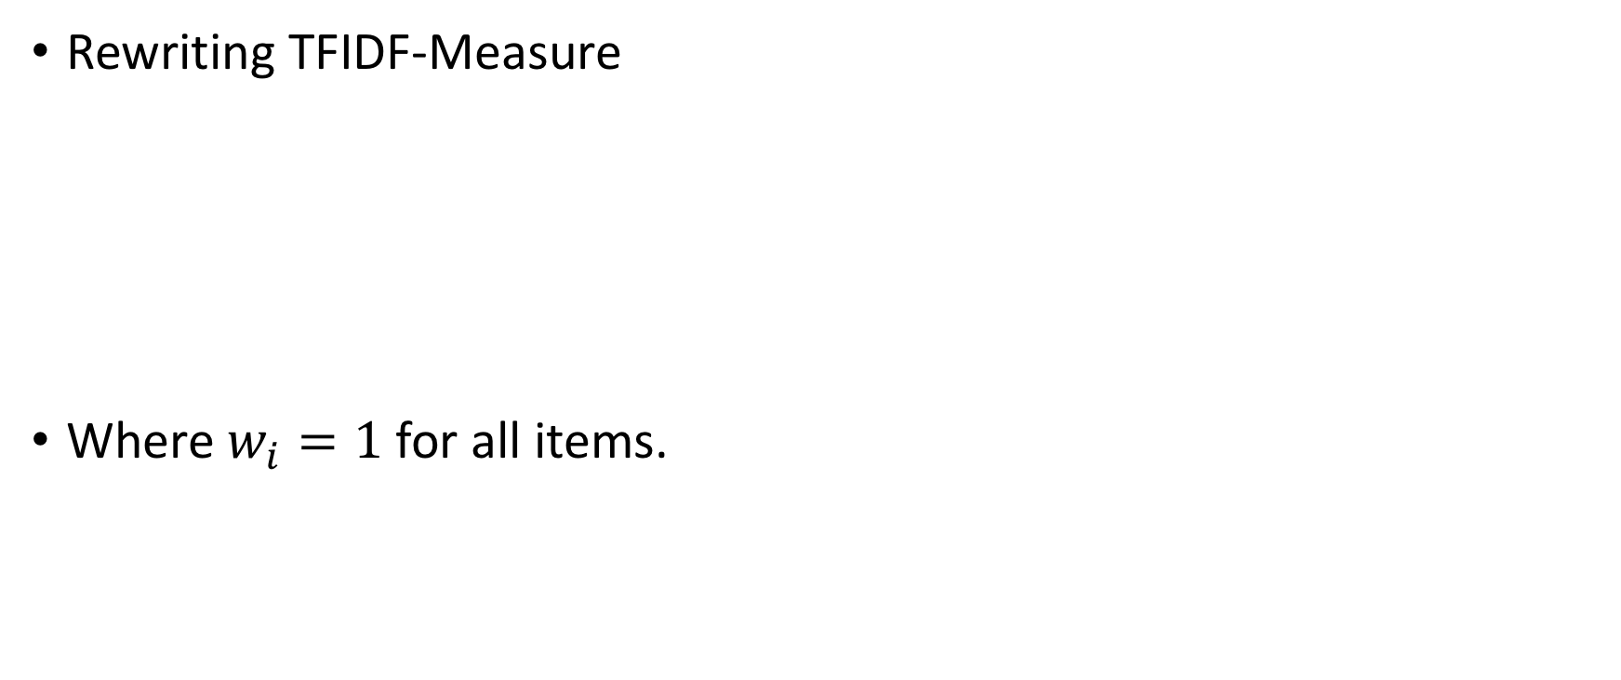
Learning Long-Tail novelty preference
Rewriting TFIDF-Measure
Where $w_{i}=1$ for all items.

Slide 52
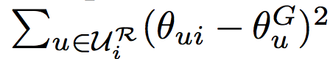
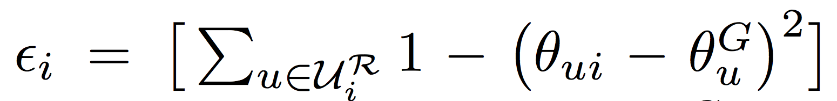
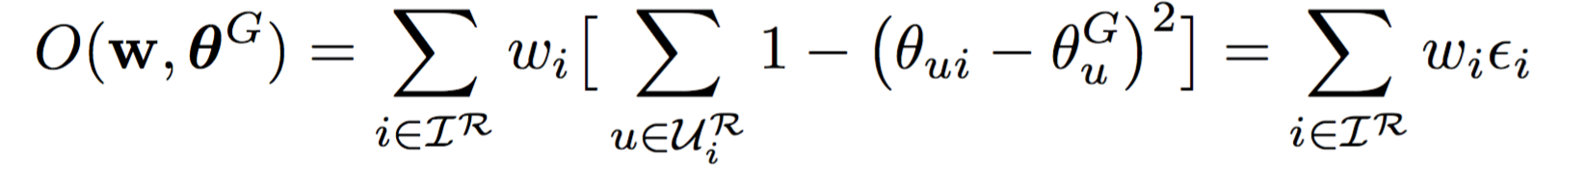
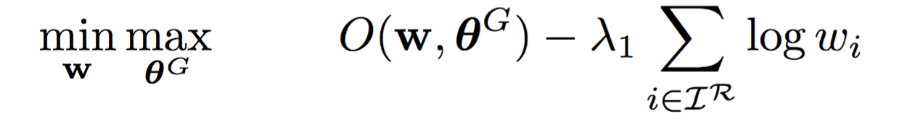
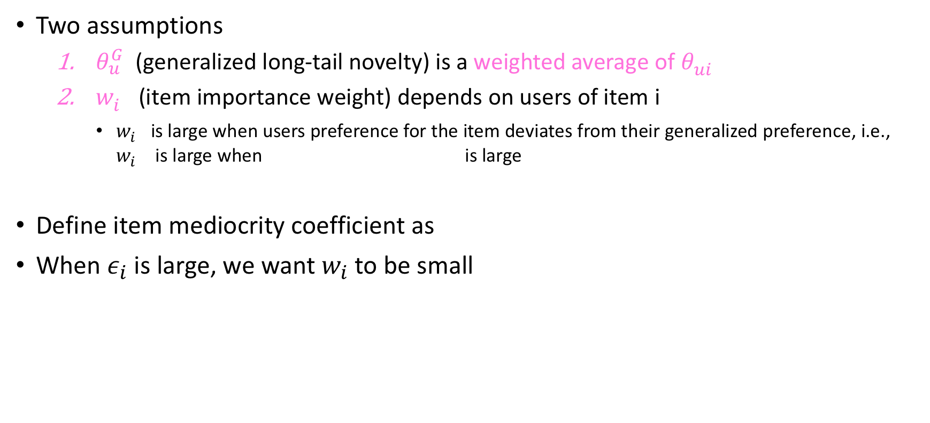
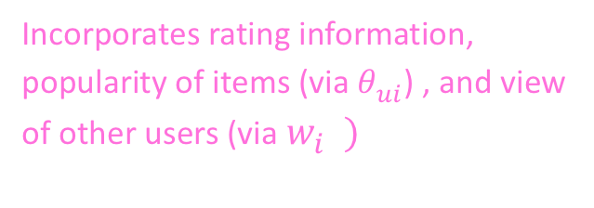
Learning Long-Tail novelty preference
Two assumptions
$θ_{u}^{G}$ (generalized long-tail novelty) is a weighted average of $θ_{ui}^{}$
$w_{i}^{}$(item importance weight) depends on users of item i
$w_{i}^{}$is large when users preference for the item deviates from their generalized preference, i.e., $w_{i}^{}$ is large when is large
Define item mediocrity coefficient as
When $ε_{i}$ is large, we want $w_{i}$ to be small
Total item mediocrity
Incorporates rating information, popularity of items (via $θ_{ui}^{}$) , and view of other users (via $w_{i}^{})$
Solve iteratively

Slide 53
GANC: Accuracy Recommender
Focuses on making accurate suggestions
Used existing models from literature
Regularized SVD [KBV09]
Rating prediction model
PureSVD [CKT10]
Top-N recommendation algorithm
Most Popular [CKT10]
Suggests accurate, yet trivial top-N sets

Slide 54
GANC: Coverage Recommender
Focus on increasing coverage
Random
Static
Consider how many times the item was rated in the past
Gain of recommending an item is proportionate to the inverse of its frequency in train set
GANC with Static coverage results in a modular set function optimization problem
Dynamic
Consider how many times item has been recommended so far
Gain of recommending an item is proportionate to the inverse of item recommendation frequency
GANC with Dynamic coverage is submodular across users
Submodular function maximization s.t a partition matroid constraint
Locally greedy is not scalable!
Designed a sampling-based locally greedy using the long-tail novelty preference.
Notes:
Needs to configure parameters with every recommendation
Sequential in nature
Creates dependency between user value functions

Slide 55
GANC with Dynamic Coverage
Dynamic coverage leads to scalability problem
Make parallel for the purpose of scalability
Design a sampling-based locally greedy algorithm
Notes:
plugging Dyn in GANC
Dyn considered the recommendations that have been made so far
It is sequential in natuere and there is a dependency between user value functions
Which creates scalability problems
Make alg parallel for the purpose of scalability
GANC with Dynamic coverage recommender
Set function optimization problem
Dependency between user value functions
Ordered sampling-based locally greedy optimization
Uses KDE to construct the PDF of user novelty preference and samples a set of users
Requires a single parameter S, the sample size
Sequentially makes recommendations to users in sample
Users not in sample can be …
Details in paper.

Slide 56
GANC with Dynamic Coverage
Dynamic coverage leads to scalability problem
Make parallel for the purpose of scalability
Design a sampling-based locally greedy algorithm
Sort users in sample in increasing $θ_{u}$
Sequentially, for each of these users, find top-N items and configure required function parameter $\vec{F}$ for Dynamic
Notes:
plugging Dyn in GANC
Dyn considered the recommendations that have been made so far
It is sequential in natuere and there is a dependency between user value functions
Which creates scalability problems
Make alg parallel for the purpose of scalability
GANC with Dynamic coverage recommender
Set function optimization problem
Dependency between user value functions
Ordered sampling-based locally greedy optimization
Uses KDE to construct the PDF of user novelty preference and samples a set of users
Requires a single parameter S, the sample size
Sequentially makes recommendations to users in sample
Users not in sample can be …
Details in paper.

Slide 57
GANC with Dynamic coverage
Dynamic coverage leads to scalability problem
Make parallel for the purpose of scalability
Design a sampling-based locally greedy algorithm
Sort users in sample in increasing $θ_{u}$
Sequentially, for each of these users, find top-N items and configure required function parameter $\vec{F}$ for Dynamic
In parallel, for remaining users, use $\vec{F}$ and corresponding $θ_{u}$ to find Top-N set
Notes:
plugging Dyn in GANC
Dyn considered the recommendations that have been made so far
It is sequential in natuere and there is a dependency between user value functions
Which creates scalability problems
Make alg parallel for the purpose of scalability
GANC with Dynamic coverage recommender
Set function optimization problem
Dependency between user value functions
Ordered sampling-based locally greedy optimization
Uses KDE to construct the PDF of user novelty preference and samples a set of users
Requires a single parameter S, the sample size
Sequentially makes recommendations to users in sample
Users not in sample can be …
Details in paper.

Slide 58
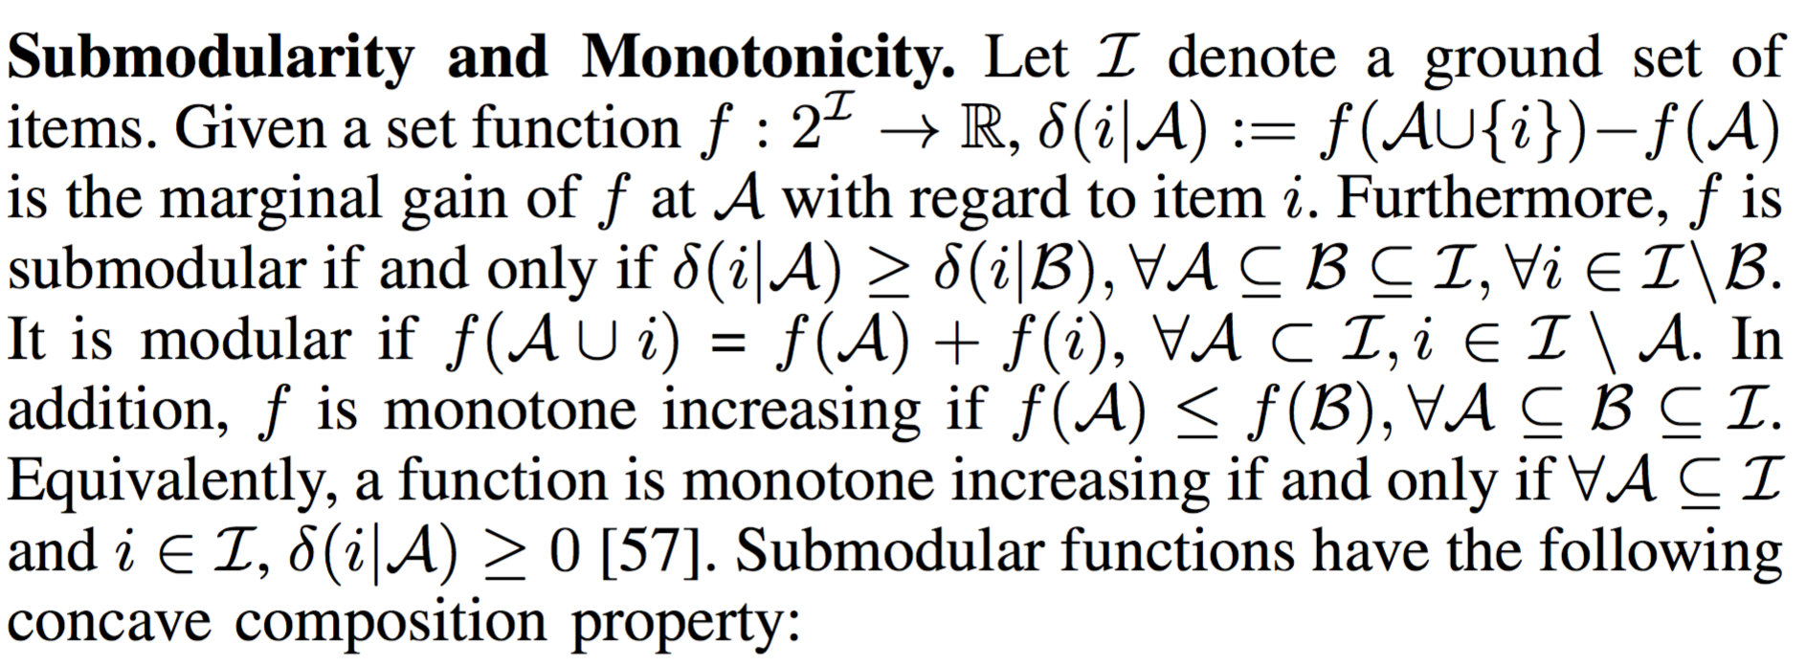
Submodularity

Slide 59
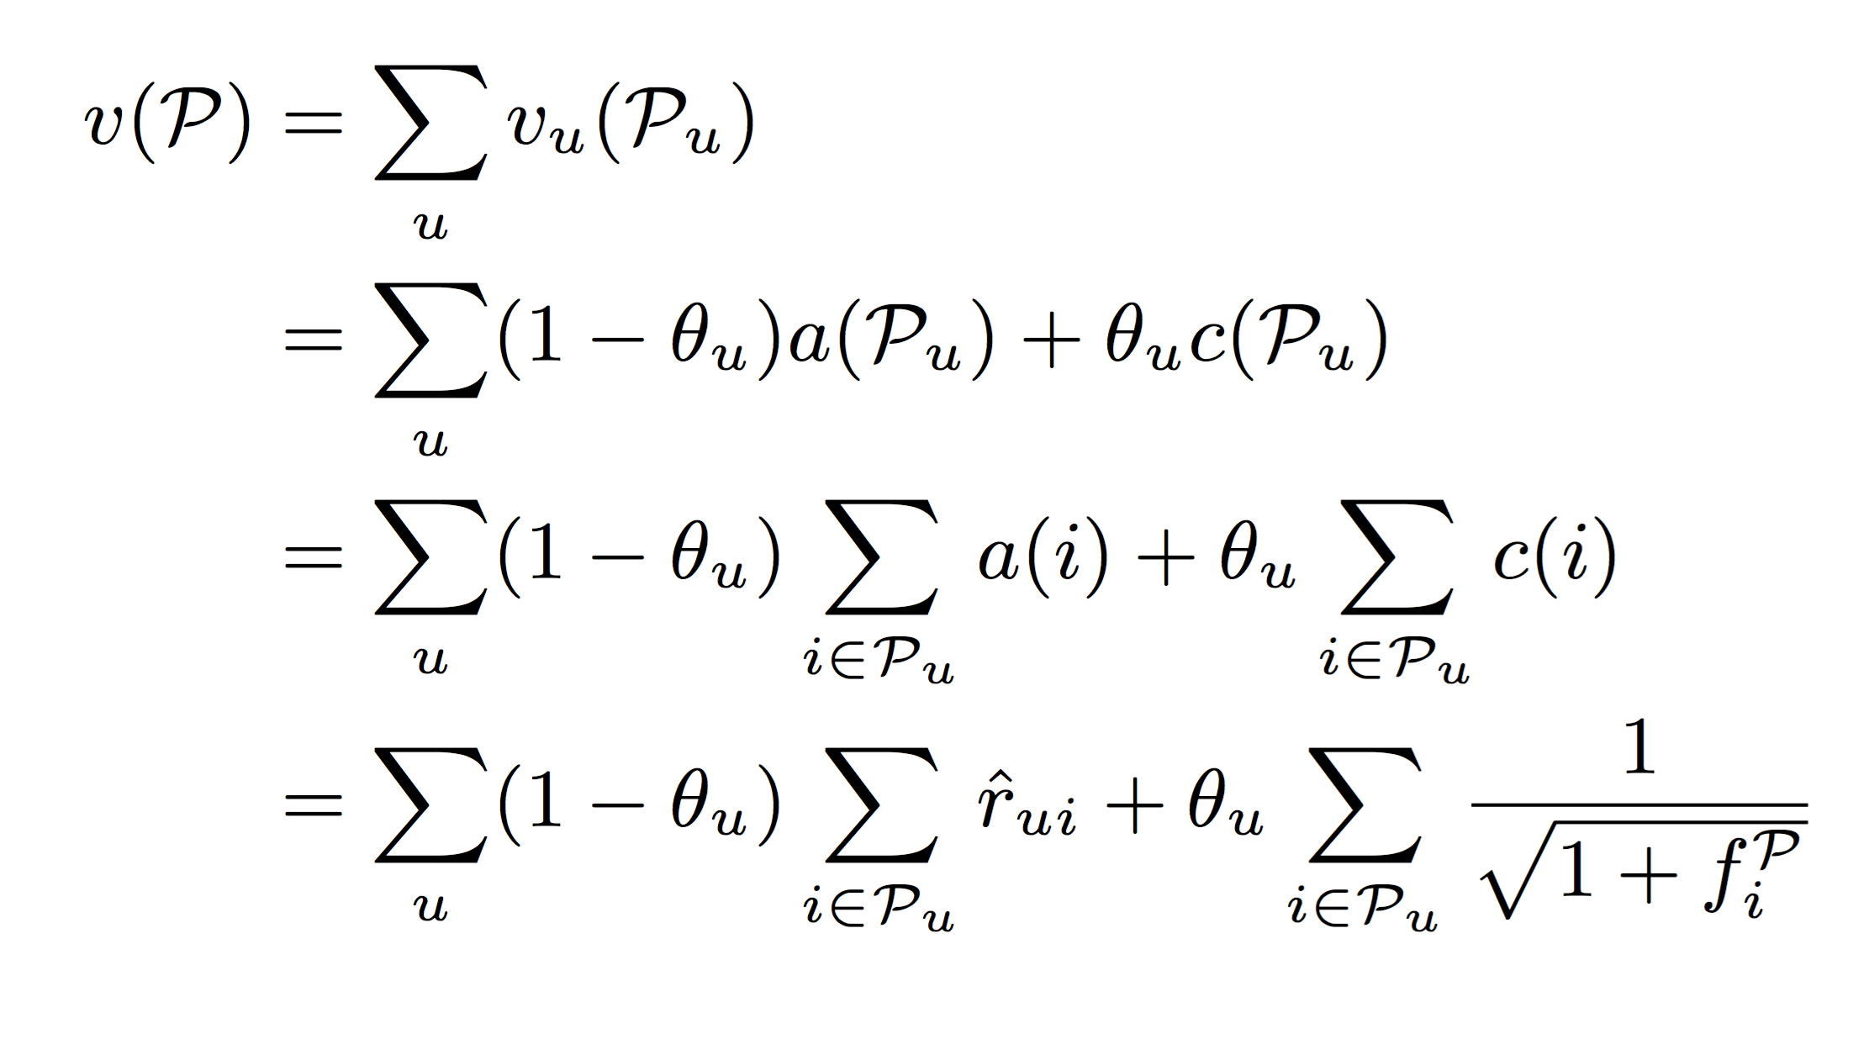
Submodularity proof

Slide 60
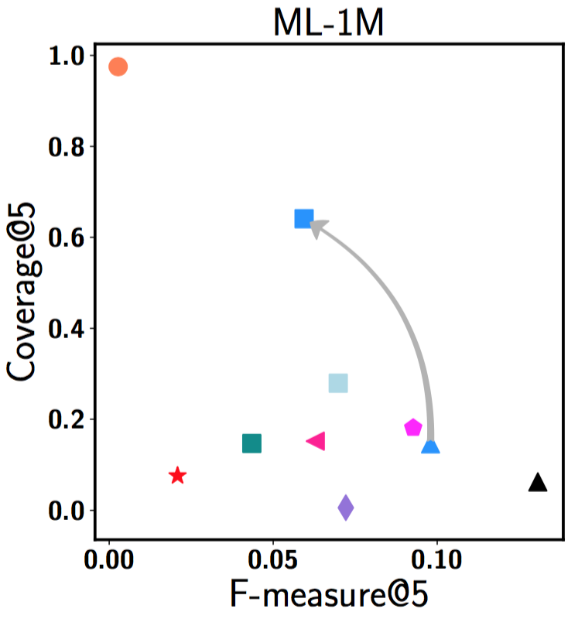
Challenges: Evaluation
Need to assess multiple aspects
Accuracy, novelty, and coverage
No single measure that combines all aspects. Report trade-offs?
Need to consider real-world settings
Datasets are sparse
Users provide little feedback
Coverage
Accuracy

Slide 61
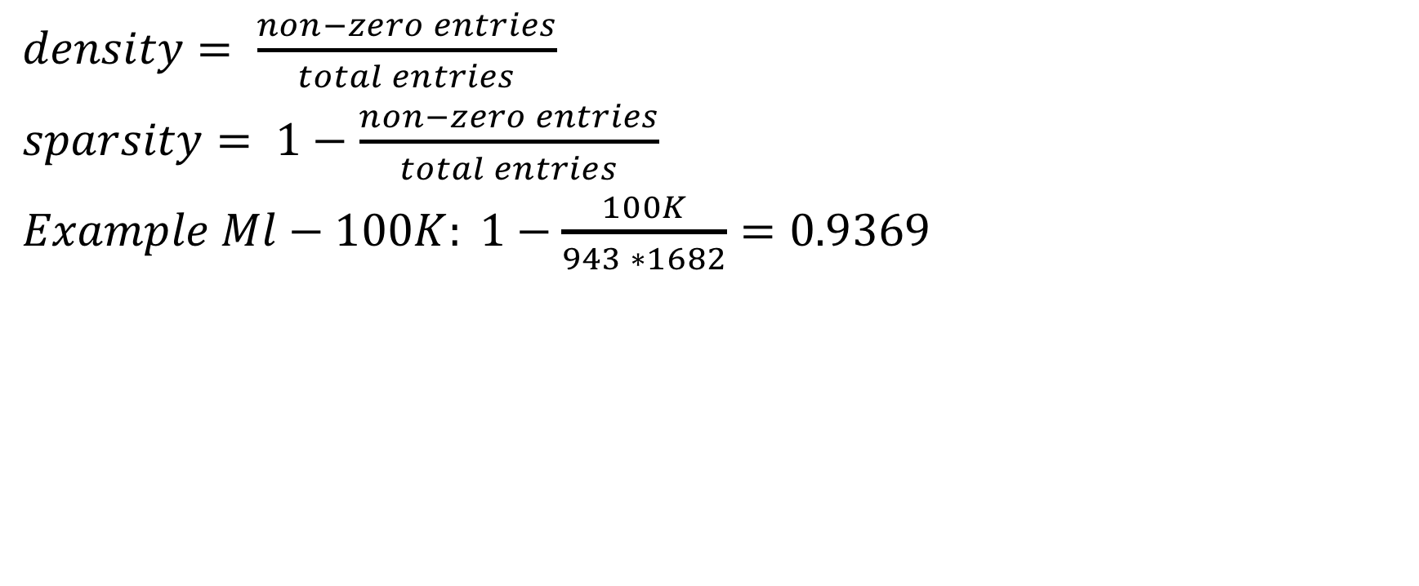
Definition of Sparsity
$density= \frac{non−zero entries}{total entries}$
$sparsity= 1−\frac{non−zero entries}{total entries}$
$Example Ml−100K: 1−\frac{100K}{943 ∗1682}=0.9369$

Slide 62
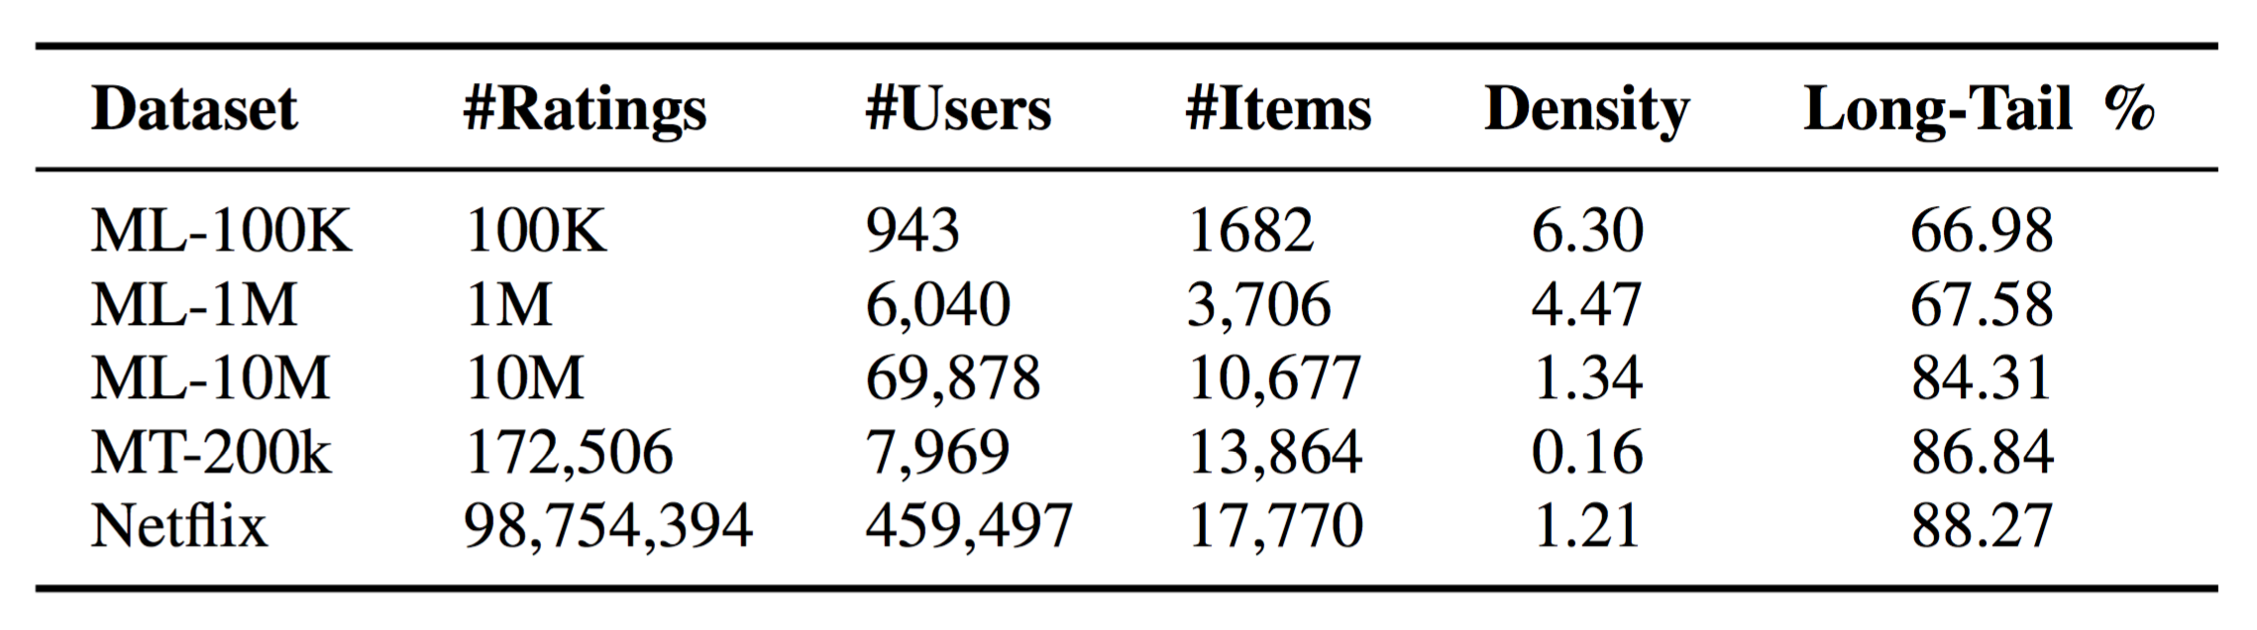
Empirical Evaluation
ML = MovieLens, MT = MovieTweetings
ML, MT, and Netflix are common recommender datasets
Datasets have varying level of density
Empirically validated that long-tail items make up a large portion of the datasets
Notes:
Minimum number of ratings per user and train-test ratio per user are removed from this slide

Slide 63
Empirical Evaluation
Performance metrics
Local ranking accuracy metrics
Precision, Recall, F-measure
Long-tail promotion metrics
LTAccuracy (emphasizes novelty and coverage), Stratified Recall (emphasizes novelty and accuracy)
Coverage metrics
Coverage, Gini
Test ranking protocol [Ste13, CKT10]
“All unrated items test ranking protocol”
Generate the top-N set of each user, by ranking all items that do not appear in the train set of that user
Notes:
Do not reward popularity-biased algorithms
Otherwise, “Most popular” highly accurate

Slide 64
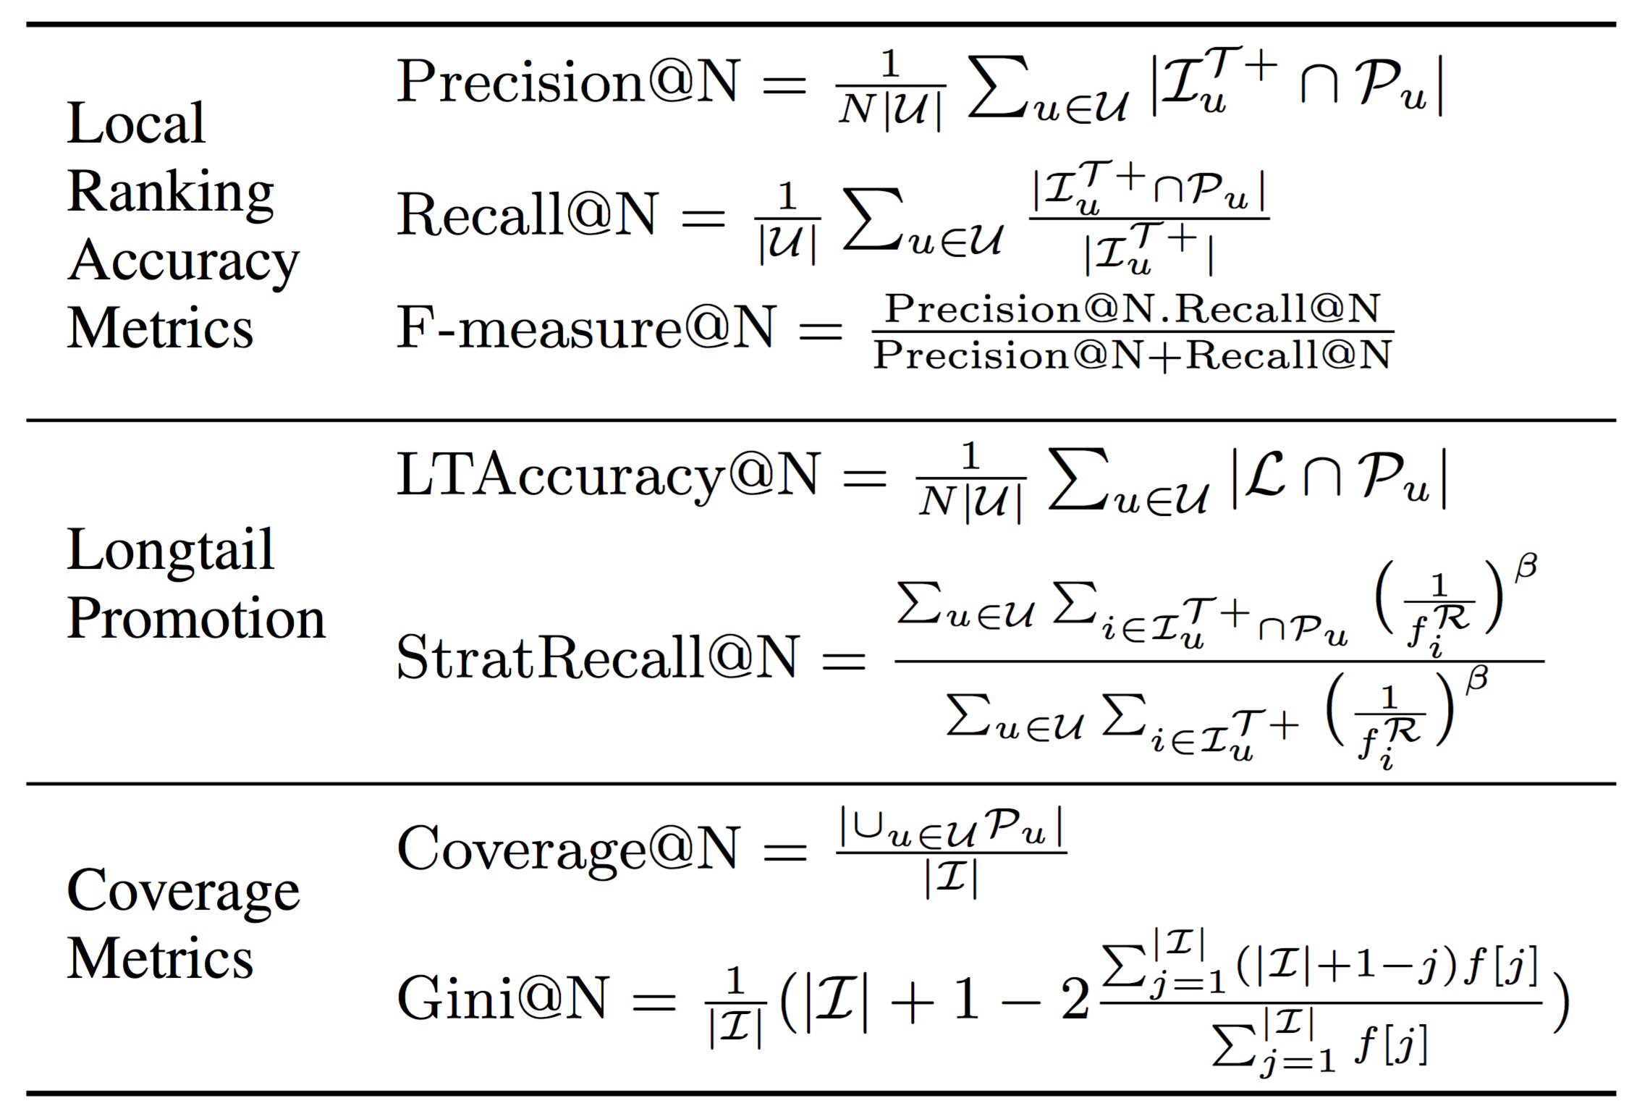
Empirical Evaluation: Performance metrics
2

Slide 65
Histograms of Long-tail Novelty Preference Estimates
ML-1M
Netflix
$θ_{u}^{Activity}$ is skewed to the right
Majority of users provide little feedback and have small activity
$θ_{u}^{Generalized}$ increases variance and identifies more categories of users
Notes:
Goal is to differentiate between users.

Slide 66
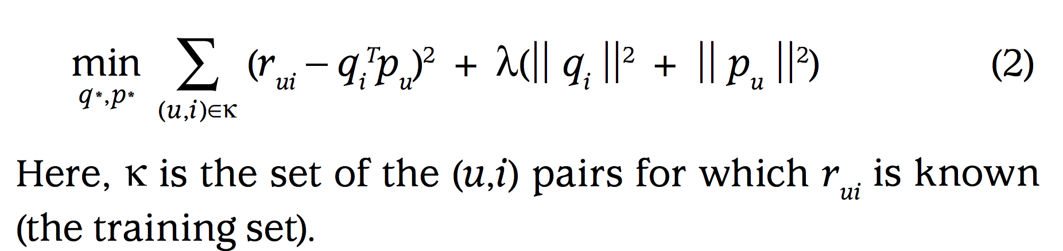
Comparison with Re-rankings Models for Rating-prediction
Rating prediction base accuracy recommender
Regularized SVD (RSVD)
Baselines
RSVD
Resource Allocation (5D)
Ranking-based Techniques (RBT)
Personalized Ranking Adaptation (PRA)
Report results for two variants of each algorithm

Slide 67
Comparison with Re-rankings Models for Rating-prediction
Dense dataset
ML-1M
RSVD is base accuracy recommender
Lower height is better
Corresponds to better rank
GANC
Outperforms RSVD in 4 metrics, including accuracy
Obtains best average performance

Slide 68
Comparison with Re-rankings Models for Rating-prediction
Sparse dataset
ML-10M
RSVD is base accuracy recommender
Lower height is better
Corresponds to better rank
Performance of all models degrades
RSVD has low accuracy to begin with.
But for sparse datasets, we can plugin a different accuracy recommender …

Slide 69
Comparison with Top-N item Recommendation Models
Base accuracy recommender
Most popular (Pop)
No longer in the domain of rating prediction
Modify baselines
Top-N recommendation baselines
Pop
Random (Rand)
Regularized SVD (RSVD)
CofiRank (CofiR100)
PureSVD with 10 factors (PSVD10)
PureSVD with 100 factors (PSVD100)
Personalized Ranking adaptation (PRA)

Slide 70
Comparison with Top-N item Recommendation Models
GANC
Plugin the non-personalized algorithm Pop as accuracy recommender
Competitive with PSVD100 and more sophisticated algorithms like CofiR100

Slide 71
Performance of GANC with Dynamic coverage
Using the popular RSVD model as base accuracy recommender
Comparing against random and constant coverage
F-measure increases
Notes:
Effect of the user long-tail novelty preference model, the accuracy recommender and their interplay

Slide 72
Performance of GANC with Dynamic coverage
Stratified recall emphasizes novelty and accuracy
Stratified recall improves across N
Notes:
Effect of the user long-tail novelty preference model, the accuracy recommender and their interplay

Slide 73
Performance of GANC with Dynamic coverage
LTAccuracy emphasizes novelty and coverage
RSVD recommends the same long-tail items to all users
Notes:
Effect of the user long-tail novelty preference model, the accuracy recommender and their interplay

Slide 74
Performance of GANC with Dynamic coverage
Coverage improves
This result is the same for all base recommenders and all datasets
Notes:
Effect of the user long-tail novelty preference model, the accuracy recommender and their interplay

Slide 75
Performance of GANC with Dynamic coverage
Lower gini shows balance in recommendations
Random long-tail novelty preference and constant obtain best performance
Notes:
Effect of the user long-tail novelty preference model, the accuracy recommender and their interplay

Slide 76
Performance of GANC with Dynamic coverage
Considering all metrics at the same time
Notes:
Effect of the user long-tail novelty preference model, the accuracy recommender and their interplay

Slide 77
Performance of GANC with Dynamic coverage
Accuracy recommender is PSVD100
Increasing sample size decreases accuracy but increases coverage
Accuracy recommender is PSVD10
The bump is due to the base recommender PSVD10
Notes:
Effect of sample size
Its not a fundamental property of recommenders that increasing coverage decreases accuracy
It depends on the base recommenders
But the general trend we observed is …

Slide 78
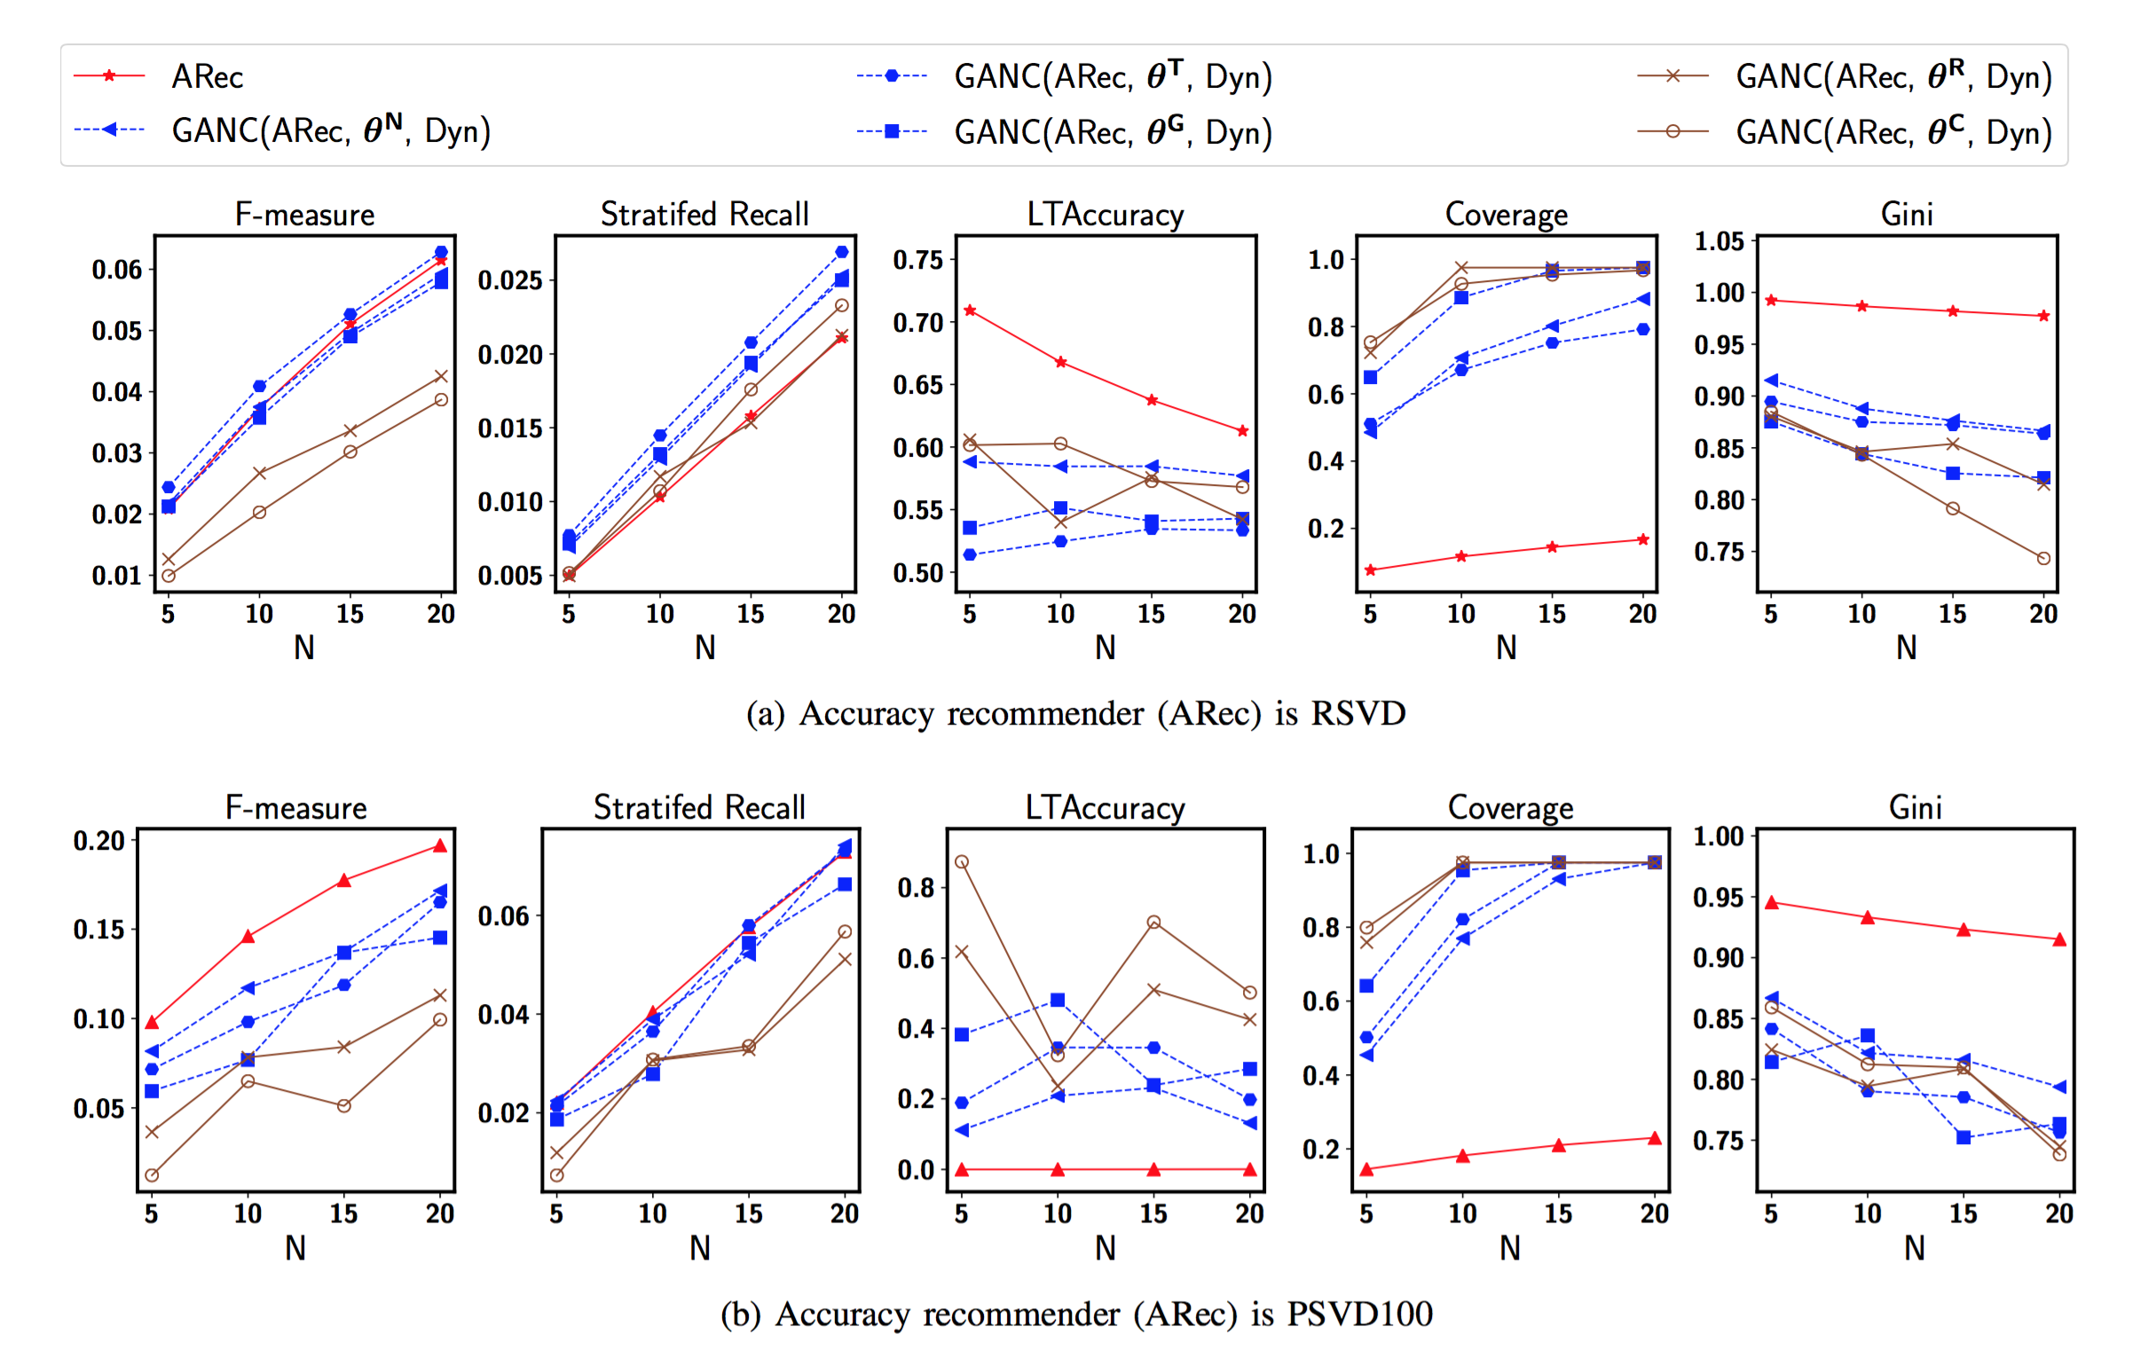
Performance of GANC with Dynamic coverage
Notes:
Effect of the user long-tail novelty preference model, the accuracy recommender and their interplay

Slide 79
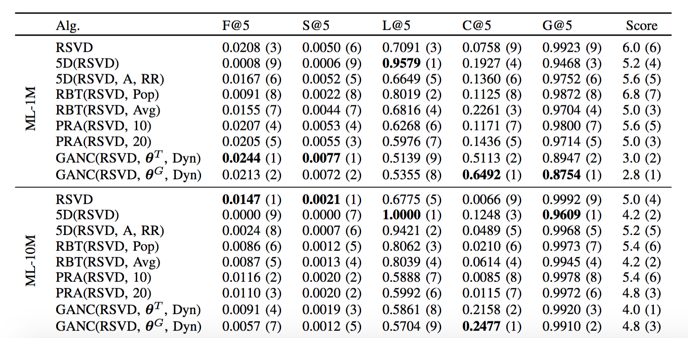
Comparison with re-rankings models for rating-prediction

Slide 80
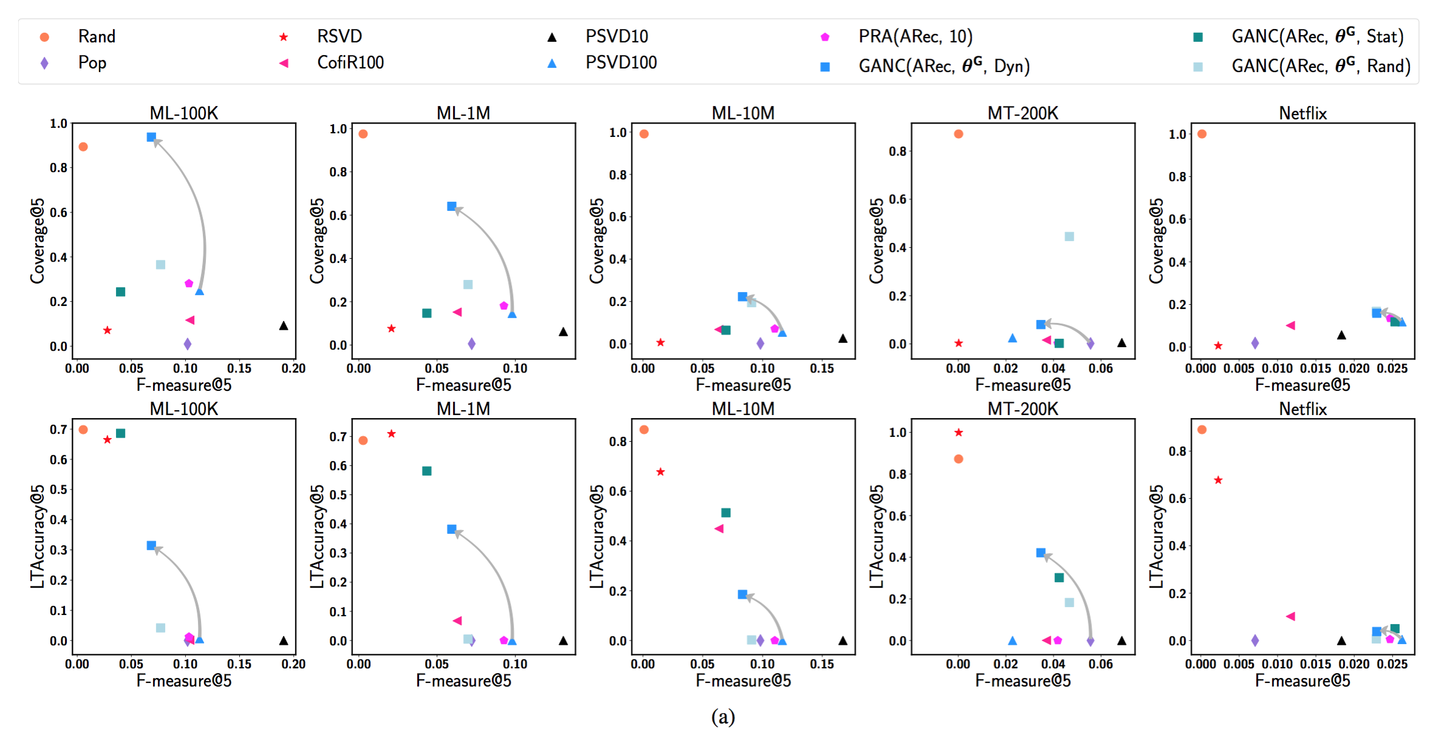
Comparison with top-N item recommendation models

Slide 81
Results: Sparse Settings
Novelty2
Coverage2
Accuracy measured by f-measure@5
Novelty measured by LTAccuracy@5[cite?]
Coverage measured by Coverage@5
Accuracy
Accuracy
GANC
Plugin the non-personalized algorithm Pop as accuracy recommender
Competitive with PSVD100 and more sophisticated algorithms like CofiR100

Slide 82
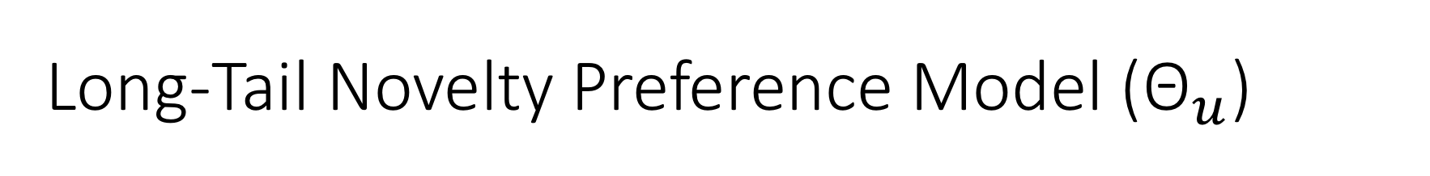
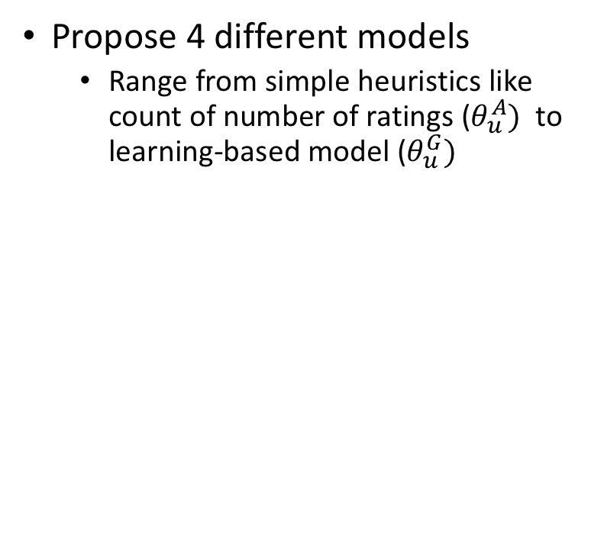
Long-Tail Novelty Preference Model (${\text{Θ}}_{u}$)
Propose 4 different models
Range from simple heuristics like count of number of ratings ($θ_{u}^{A})$ to learning-based model ($θ_{u}^{G})$
Learning Long-Tail novelty preference
Assumptions
Items have an importance weight
Users have an average …
Solve iteratively
ML-1M
Notes:
Normalized long-tail measure
TFIDF-Measure

Slide 83

Approach Overview: GANC
Identify broader categories of users
Proposed 4 models for estimating Long-Tail novelty preference for each user ($θ_{u}$)
Activity measure
Number observations in train set (e.g., number of rated items)
Normalized long-tail measure
Ratio of long-tail items they have rated in train set
TFIDF-Measure
Incorporates rating and popularity of items
Generalized measure
Optimization approach
Incorporates rating information, popularity of items, and view of other users
ML-1M
Notes:
Does not distinguish between long-tail and popular items
Does not consider whether user liked the item
Does not consider view of other users

Slide 84
Approach Overview: GANC
Identify broader categories of users
Proposed 4 models for estimating Long-Tail novelty preference for each user ($θ_{u}$)
Activity measure
Number observations in train set (e.g., number of rated items)
Normalized long-tail measure
Ratio of long-tail items they have rated in train set
TFIDF-Measure
Incorporates rating and popularity of items
Generalized measure
Optimization approach
Incorporates rating information, popularity of items, and view of other users
ML-1M
Notes:
Does not distinguish between long-tail and popular items
Does not consider whether user liked the item
Does not consider view of other users

Slide 85

Approach Overview: GANC Features
Proposed 4 long-tail novelty preference ${(θ}_{u}$) models
Including Generalized measure
Optimization approach
Popularity of items, rating information, and view of other users
ML-1M
Identify broader categories of users
Notes:
Activity measure
Number observations in train set
Normalized long-tail measure
Incorporates popularity of items
TFIDF-Measure
Incorporates rating and popularity of items
Generalized measure
Optimization approach
Incorporates rating information, popularity of items, and view of other users

Slide 86
Part 2

Slide 87

Part 3: Objectives
Setup
Use large-scale and real-world query workloads
No access to database statistics or query execution plans!
Consider different problem settings
Depending on new query $Q_{∗}$and the workload 𝑾
Goal
Predict properties of SQL queries – prior to execution
Establish appropriate baselines w.r.t. data properties
Assess feasibility of complex queries
Notes:
- We want to do this under different problem settings
-

Slide 88
Facilitating SQL Query Composition and Analysis: Motivation
Inefficient SQL queries
Detrimental for both system resources and user time and effort
To write efficient SQL queries
Gain knowledge of database schema, tuples
Consider query execution plans
Can be imprecise [BDM19]
Rely on database statistics and heuristics
Use hints or tutorials offered by system
E.g., write ``Count’’ queries before submitting query
Provide SQL query performance insights automatically?
Notes:
users can submit long running jobs, its possible job stops executing in the second week.

Slide 89
Workloads
We use 2 real-world query workloads
Sloan Digital Sky Server (SDSS) [RTS14]
Scientific computing domain, astronomy
Publicly available
Accumulated over 20 years
Extracted ~600K SQL queries
SQLShare [JMH16]
Users upload data, write queries, and share
Contains ~27K SQL queries

Slide 90
Approach Overview
Setup
Use large-scale and real-world query workloads
No access to database statistics or query execution plans!
Consider different problem settings
Depending on new query $Q_{∗}$and the workload 𝑾
Goal
Predict SQL query performance properties – prior to execution
Understand data properties
Establish appropriate baselines
Assess feasibility of complex queries
Notes:
- We want to do this under different problem settings
-

Slide 91


Models Evaluated
Simple baselines
Most frequent (mfreq) class for classification
Median of distribution (median) for regression
Bag-of-ngrams and tfidf
Character level (ctfidf)
Word level (wtfidf)
Shallow Convolutional Neural Network (CNN)
Character level (ccnn)
Word level (wcnn)
3-Layer Long Short-Term Memory (LSTM)
Character level (clstm)
Word level (wlstm)
Notes:
Justify why these are chosen
Common in other nlp domains
Sequential

Slide 92
Models Evaluated
Simple baselines
Most frequent (mfreq) class for classification
Median of distribution (median) for regression
Bag-of-ngrams and tfidf
Character level (ctfidf)
Word level (wtfidf)
Shallow Convolutional Neural Network (CNN)
Character level (ccnn)
Word level (wcnn)
3-Layer Long Short-Term Memory (LSTM)
Character level (clstm)
Word level (wlstm)
Objective function
Huber loss for regression
Cross-entropy for classification
Optimizer
Adam
Notes:
Justify why these are chosen

Slide 93

Workload Analysis: Statement Complexity
We want to help users write complex queries
Query statement complexity should reflect the cognitive effort required to write the query
Some properties are linearly correlated with, and therefore, indicative of other properties
Use subset of structural properties
Notes:
Execution plan
better capture query complexity
char_length, function_count, join_count, nested_count, nested_aggregate

Slide 94
Results: Answer size prediction
Homogeneous instance
Model | MSE | Huber loss
Median | 16.1348 | 1.6357
ctfidf | 7.8824 | 1.0400
ccnn | 5.7005 | 0.7517
clstm | 6.1719 | 0.7678
wtfidf | 8.5783 | 1.0922
wcnn | 6.1791 | 0.8472
wlstm | 6.5468 | 0.8256
Notes:
Character-level model obtain lowest Mean Square Error (MSE)
Traditional models obtain similar performance as Median
Considering session class information
noWebhit, PROGRAM, and BROWSER classes are difficult to predict
they may have more diverse queries.

Slide 95
Results: CPU time prediction
Model | Homogenous Instance | Homogeneous Schema | Heterogenous Schema
Median | 0.0675 | 2.0049 | 2.1616
ctfidf | 0.0668 | 0.4742 | 1.2360
ccnn | 0.0471 | 0.4625 | 1.1547
clstm | 0.0452 | 0.7935 | 1.6046
wtfidf | 0.0668 | 0.4898 | 1.9702
wcnn | 0.0441 | 0.5230 | 2.0416
wlstm | 0.0442 | 0.8081 | 1.8546
Model | Homogeneous Instance | Homogeneous Schema | Heterogenous Schema
Median | 0.2889 | 8.9001 | 8.3925
ctfidf | 0.2859 | 1.6606 | 4.2818
ccnn | 0.1679 | 1.4406 | 4.3119
clstm | 0.173 | 3.1303 | 7.0019
wtfidf | 0.2862 | 1.6945 | 8.8983
wcnn | 0.1646 | 1.6389 | 9.0046
wlstm | 0.1604 | 3.4004 | 11.8959
Huber loss
MSE

Slide 96
Results: CPU time prediction
Character level vs word level: Character level models obtain best overall result w.r.t. to both metrics
Data distributions become more heterogenous and make it more difficult to learn patterns at the word level (many unseen words in test set)
LSTM vs CNN: LSTMs try to preserve long-term dependencies in sequential data, CNNs identify n-grams or local patterns
Sql code snippets are long and it would be difficult to preserve long-term dependencies

Slide 97




Results: CPU Time Prediction in Different Settings
In all 3, MSE increases as character length increases (performance degrades)
From left to right, range of MSE values increases
The problem is harder as we go to heterogenous setting
Character-level models obtain lowest Mean Square Error (MSE) and test loss value
Notes:
CPU Time Prediction by Query Character Length Under Various Settings
Traditional models obtain similar performance as Median
Considering session class information
noWebhit, PROGRAM, and BROWSER classes are difficult to predict
they may have more diverse queries.

Slide 98
Results: CPU time prediction by session class
Homogenous instance (SDSS)
Character-level model obtain lowest MSE
Traditional models obtain similar performance as Median
Considering session class information
noWebhit, PROGRAM, and BROWSER classes are difficult to predict
They may have more diverse queries.

Slide 99
Results: Answer Size Prediction

Slide 100
Results: Answer size prediction by session class
Homogeneous instance(SDSS)
Character-level model obtain lowest MSE
Traditional models obtain similar performance as Median
Considering session class information
noWebhit, PROGRAM, and BROWSER classes are difficult to predict
they may have more diverse queries.

Slide 101

Results: Answer Size Prediction by Query Statement Complexity
Homogeneous instance (SDSS)
Dip in MSE is due to fewer answers for corresponding queries (Property of dataset)

Slide 102
Results: Error Classification
Problem is imbalanced
Test accuracy high for all models
ccnn highest overall accuracy
F-measure per class
Most neural networks models (and wtfidf) can predict classes with fewer samples

Slide 103
Results: Session Classification
Homogeneous instance (SDSS)
Classification problem is imbalanced
ctfidf obtains best test accuracy
but cannot identify samples from unknown class),
ccnn obtain better performance across all classes
Notes:
Most Frequent obtains lowest Test Accuracy

Slide 104
Case study
Query properties
Char_length = 1247, word_length=376
Joins 3 large tables
Specobj= ~4.3m
Photoobj= 800m rows
CPU time =105.37 sec
Answer size =304 rows
Predicted values
clstm prediction 980 sec
ccnn prediction 116.4 sec
Long query length makes it hard for lstm to capture the long term dependencies while ccnn detects local patterns and combines them globally
Notes:
Session_Class = browser
Error_class = success
CPU time =105.37 sec
Answer size =304 rows

Slide 105
Part 3

Slide 106

Finding high coverage intervals - optimization approach

Slide 107

Results: Processing Overhead of Operations
KDE dominates the processing overhead for extracting statistics
Sampling the viable answers dominates the overall time needed for sampling and extracting statistics

Slide 108
Selected Related work
Accuracy-focused models
KBV09- Koren, Yehuda, Robert Bell, and Chris Volinsky. "Matrix factorization techniques for recommender systems." Computer42.8 (2009).
WKL+08- Weimer, Markus, et al. "Cofi rank-maximum margin matrix factorization for collaborative ranking." Advances in neural information processing systems. 2008.
Re-ranking frameworks
AK12- Adomavicius, Gediminas, and YoungOk Kwon. "Improving aggregate recommendation diversity using ranking-based techniques." IEEE Transactions on Knowledge and Data Engineering 24.5 (2012): 896-911.
HCH14- Ho, Yu-Chieh, Yi-Ting Chiang, and Jane Yung-Jen Hsu. "Who likes it more?: mining worth-recommending items from long tails by modeling relative preference." Proceedings of the 7th ACM international conference on Web search and data mining. ACM, 2014.
Evaluation of top-N recommendation
CKT10- Cremonesi, Paolo, Yehuda Koren, and Roberto Turrin. "Performance of recommender algorithms on top-n recommendation tasks." Proceedings of the fourth ACM conference on Recommender systems. ACM, 2010.
Ste11- Steck, Harald. "Item popularity and recommendation accuracy." Proceedings of the fifth ACM conference on Recommender systems. ACM, 2011.
Ste13- Steck, Harald. "Evaluation of recommendations: rating-prediction and ranking." Proceedings of the 7th ACM conference on Recommender systems. ACM, 2013.
Notes:
[CKT10, Ste11,Ste13]

